Slide 1








Long COVID/Post COVID syndrome in children and young people Assessment and management for paediatricians
 | Outcomes of Children and Young People seen in a tertiary Long COVID specialist clinic: a service evaluation
Dr Terry Segal
Consultant Adolescent Paediatrician, University College London Hospitals
On behalf of the Pan London CYP Post COVID Service
Jo Bond Kendall
Senior Specialist Physiotherapist.
Paediatric Specialist Fatigue Service RUH Bath.

Slide 2
Plan
How to assess a child or young people with fatigue and other symptoms who may have long COVID
Differential diagnoses, Co-morbidities
Management

Slide 3

Case – 15 year old male
Unwell for 8 months with fatigue
Had likely COVID infection 6 weeks prior to symptoms
Most impactful symptoms :
Fatigue, dizziness, headaches, poor sleep, nausea,
Difficulty concentrating, memory loss,
Post exertional malaise and symptom exacerbation
Unable to play football any more
Anxiety (in relation to school) Past history of post viral fatigue (10 years of age)
Under assessment for SpLD -Dyslexia
Previously active (football, hockey) alongside full time school
Family/social history- father working abroad since he became unwell, sister autism diagnosis, mother anxiety
Now: Not attending school, little routine, poor sleep, irregular meals, gaming/ YouTube (10 hours daily)
Notes:
Terry
Write down the preceeding, precipitating and perpetuating factors

Slide 4
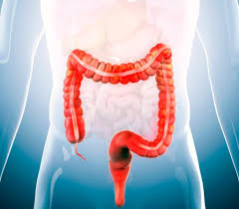
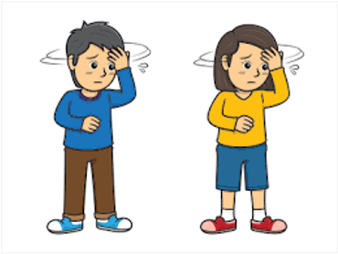

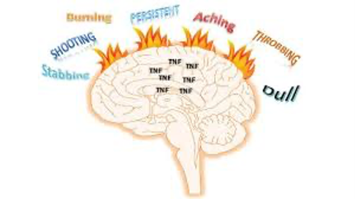


Differential diagnoses/ comorbidities
ME/CFS
Long COVID
IBS/IBD
Dysautonomia
Mood
Chronic pain
Anxiety, panic, PTSD
Neurodivergence

Slide 5

Diagnosing ME/CFS( NG206)
Significant fatigue
Flu like symptoms
Heightened sensory sensitivity
worsened by activity, not caused by exertion, not relieved by rest
Post exertional malaise
after activity, often delayed, disproportionate to the activity, prolonged recovery time
Unrefreshing sleep
or sleep disturbance or both, feeling exhausted/ unwell, broken or shallow sleep, altered pattern, hypersomnia
Cognitive difficulties (brainfog)
difficulty word/ number finding/ speaking, concentration and memory problems, multitasking difficult
Debilitating fatigue
Muscle and joint aches and pain
Symptoms present for
3 months or more
Not explained by another condition
Impact of symptoms on psychological and social wellbeing
Headaches
Abdominal pain
Gastrointestinal
Nausea
Dizziness
Difficulty with concentration and memory
Sleep difficulties
Temperature hypersensitivity
Notes:
Also known as Post Exertional Symptoms Exacerbation (PESE)
PEM/PESE is a significant increase in the level of fatigue after doing your usual level of activity
Fatigue does not quickly improve with rest
Typically a delay between doing activity and fatigue increasing
Likely the result of dysregulated responses in body systems, immune, nervous, hormonal
Prolonged recovery time

Slide 6


Post Covid Syndrome Definition (Long COVID/Long haulers/ Post Covid Condition)
Persistent symptoms
> 8-12 weeks
Following SARS-CoV2
Impact on functioning
Fluctuating and relapsing course
Exclusion of alternate diagnosis
COVID-19 rapid guideline: managing the long-term effects of COVID-19 National Institute for Health and Care Excellence (NICE), Scottish Intercollegiate Guidelines Network (SIGN) and Royal College of General Practitioners (RCGP) 2022
A clinical case definition for post COVID-19 condition in children and adolescents by expert consensus, WHO February 2023
Stephenson T, Allin B, Nugawela MD, et al Long COVID (post-COVID-19 condition) in children: a modified Delphi process. Archives of Disease in Childhood 2022;107:674-680.
Notes:
So what do we mean by Long Covid or more specifically post Covid syndrome. There are 3 key definitions by Nice Who and a Delphi research definition. All broadly agree on the need for persistent ax, lasting more than 8-12’weeks following infection with sars-civ2. These have an impact on function and are not explained by any other diagnosis.

Slide 7
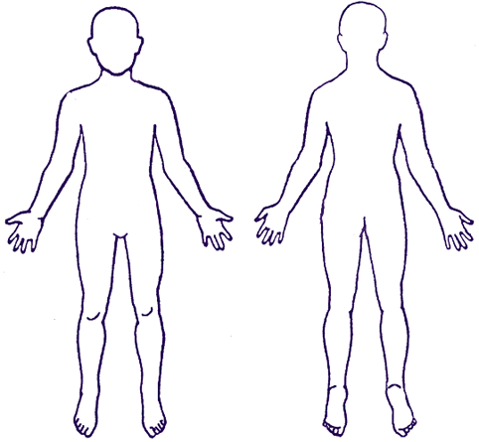
Post COVID Symptoms in CYP₅
Neurological
Headache
Dizziness
Blurred vision
Cognitive blunting/ memory issues
( brain fog)
Psychological( 25%)
Mood changes
Cardiovascular
Tachycardia/palpitations
Chest pain
Ear, Nose and Throat
Altered smell/taste
Sore throat
Dizziness
Respiratory
Breathing difficulties
Cough
Dysfunctional breathing
Dermatological
Rashes
Gastrointestinal
GI Issues
Nausea
Musculoskeletal
Joint pain
Muscle pain/spasms
weakness
Other
Fatigue
Fever
Post exertional malaise(PEM) and symptom exacerbation(PESE)
Autonomic dysfunction
It is important to note that symptoms can present as new following initial recovery or persist from initial illness, fluctuate or relapse overtime
Notes:
Commonest fatigue, headache, breathing, brain fog, post exertional malaise
Effect on YP is to miss school, or miss socialising and hobbies
We belive the psychological effects are due to the symptoms and effect on their lives
Pandemic effects as well
Presentation: What are the main symptoms?
The illness is heterogeneous and affects multiple systems. Over 200 symptoms associated with post-COVID syndrome have been reported across 9 body systems (15,20).The most commonly reported symptoms are fatigue, headache, sleep disturbance, cognitive dysfunction (‘brain fog’), abdominal pain, myalgia or arthralgia, post-exertional malaise, congested or runny nose, cough, chest tightness or pain, loss of appetite or weight, disturbed smell or anosmia, and rash (9) (Figure 1). Mood is commonly affected. Tics and functional neurological disorder have been noted.
Brain fog is a term used in post viral illnesses describing a state of difficulty concentrating, poor memory and reduced cognitive function, is common and can be debilitating.
Multiple and fluctuating symptoms are a hallmark of the condition. The CLoCk study showed that 14% more CYP with a positive COVID test had 3+ symptoms compared to those with a negative test, and 7% more who tested positive had 5+ symptoms (21).
The patient may have overlapping clusters of symptoms
The symptoms cannot be explained by an alternative diagnosis.
Fluctuation of symptoms is common, with varying severity, and follow a remitting and relapsing course
Impact on daily functioning is a key factor in diagnosis and can be debilitating (e.g., impacting educational attendance, home, or relationships)
Impact their physical, mental, or social well-being.

Slide 8
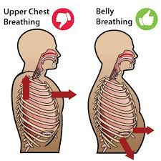
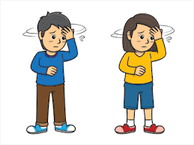
Range of presentations
ME/CFS (50%)
The young ones- post exertional malaise
Gastro symptoms
Neurological symptoms
Desaturation
Poor microvascular perfusion
Breathing Pattern
Disorder
Chronic pain
Autonomic
Rashes
Notes:
Odd clinical abnormalities picked up eg raised ASOT, Brain MRI abnormalities, raised CK after exercising
More skin/ breathing/ extremities manifestations? Role microvascular changes may play / mast cells associated with inflammation?

Slide 9
Other associations
Neurodivergence
Autoimmune conditions
Dysautonomia( POTS and inappropriate sinus tachycardia)
Hypermobility (60% in ME/CFS) and connective tissue disorders
Atopy
Mast cell activation
Pre existing functional symptoms
Mood disorders

Slide 10
The 4 main principles of managing ME/CFS and Post COVID symptoms:
Rule out differential diagnoses + secondary organ pathology from COVID-19
Rehabilitation and local support Referral to specialist services
MDT Holistic Biopsychosocial assessment
Listen with empathy about effects on their life
Medical Management of symptoms and comorbidities
eg migraine, sleep, gastro, dysautonomia
Notes:
Holistic assessment
Listen with empathy
Effects on their life
General biopsychosocial assessment
Assess for red flags
Examination

Slide 11
Assessment – Targeted History
Symptoms
Fatigue Mind/body
Include post exertional malaise( PEM) and PESE ( symptom exacerbation)
Dizziness/ orthostatic
Brain fog
Pain
History of presenting complaint
COVID infection?
PMH
Pre-xisting conditions
EDS
Hypermobility
ME/CFS
Neurodevelopmental
Family history
COVID experience
Significant life events
Illness
Mood
Activities of daily living
School/education
Sleep
Screens
Diet

Slide 12
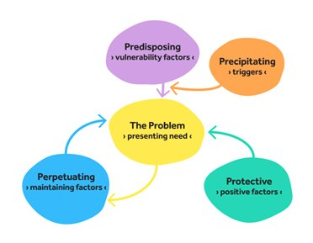
Case study
15 year old male, unwell for past 9 months started 6w after COVID
Most impactful symptoms :
fatigue, dizziness, headaches, poor sleep, nausea,
Post exertional malaise and symptom exacerbation
Difficulty concentrating, memory loss, brain fog
Anxiety (in relation to school)
Unable to play football any more
Past history of post viral fatigue (10 years of age)
Under assessment for SpLD- Dyslexia
Previously active (football, hockey) alongside full time school
Family/social history- father working abroad since he became unwell, sister autism diagnosis
Now: not attending school . little routine, poor sleep, irregular meals, gaming/ YouTube (10 hours daily),
Notes:
Terry

Slide 13
Severity
NICE recognizes four severity levels for Myalgic encephalomyelitis (ME)/Chronic fatigue syndrome (CFS):
Very severe: People are in bed all day and dependent on care
Mild: People can care for themselves and do some light domestic tasks but may have mobility difficulties.
Moderate: People have reduced mobility and are restricted in daily activities.
Severe: People are unable to do any activity for themselves or can carry out minimal daily tasks only.

Slide 14
ME/CFS and long COVID initial investigations
Essential investigations
Full blood count
ESR, CRP
HbA1c,Ferritin
Coeliac screening
Creatine kinase
Urinalysis for protein, blood and glucose
Vitamin D , B12, Folate,
Additional investigations to consider
Bedside tests
9am cortisol for adrenal insufficiency
Serology to detect infection
Other eg Brain MRI if red flags
Autoimmune screen
Coagulation screen in Long COVID vWF and AdamsTS
heart rate , 24 hour tape
NASA lean
Examination
Height and weight
General
Cardiorespiratory
Abdominal
Neurological
Skin
Renal,bone,liver
Sit/stand

Slide 15
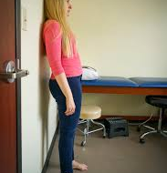
Dysautonomia
Vasovagal syncope, PoTS, orthostatic hypotension, nonspecific orthostatic intolerance of autonomic system
Symptoms in the upright position relieved when lying; Dizziness, palpitations, fatigue
Medications can contribute to autonomic dysfunction(SSRI, nortryptaline,amitriptyline)
Diagnosis -
NASA stand test or tilt table HR increases > 40bpm( withput drop of BP of 20mmHg)
24 hour HR mean >130 6-12yrs, or >125bpm 13-18years

Slide 16
The 4 main principles of managing ME/CFS and Post COVID symptoms:
Rule out differential diagnoses + secondary organ pathology from COVID-19
Rehabilitation and local support Referral to specialist services
MDT Holistic Biopsychosocial assessment
Listen with empathy about effects on their life
Medical Management of symptoms and comorbidities
eg migraine, sleep, gastro, dysautonomia
Notes:
Holistic assessment
Listen with empathy
Effects on their life
General biopsychosocial assessment
Assess for red flags
Examination

Slide 17
Common medical management
SYMPTOM/ISSUE | DRUG/TREATMENT
Fatigue, post exertional malaise brain fog | Pacing/activity management (cognitive and physical)
POTS/ dysautonomia | www.potsuk.org Salt 5g/day, 2.5L water, compression stocking B blockers, fludrocortisone, midodrine, ivabradine (after ECG/24hr tape/echocardiogram) D/W cardiologist
Sleep | Sleep hygiene Melatonin 4mg nocte
Migraine treatment | As per usual protocols
Pain | Psychoeducation, Amitripyline 10mg (not if dysautonomia)
GI symptoms/ MCAS | Probiotics, Anti-emetics H1 + H2 block – famotidine + cetirizine etc
Anxiety , low mood | Talking therapies, consider SSRI

Slide 18
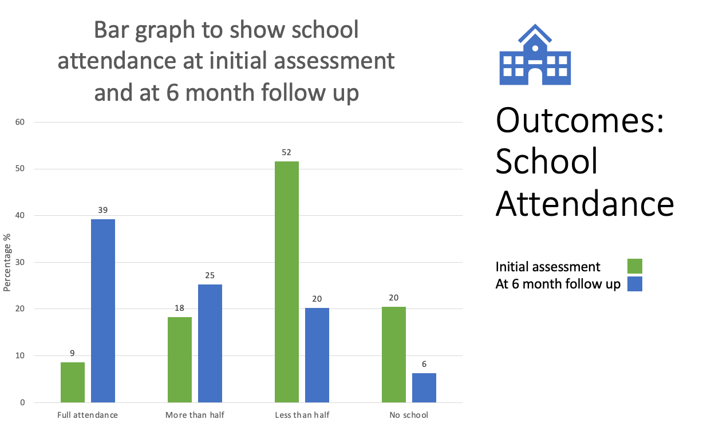
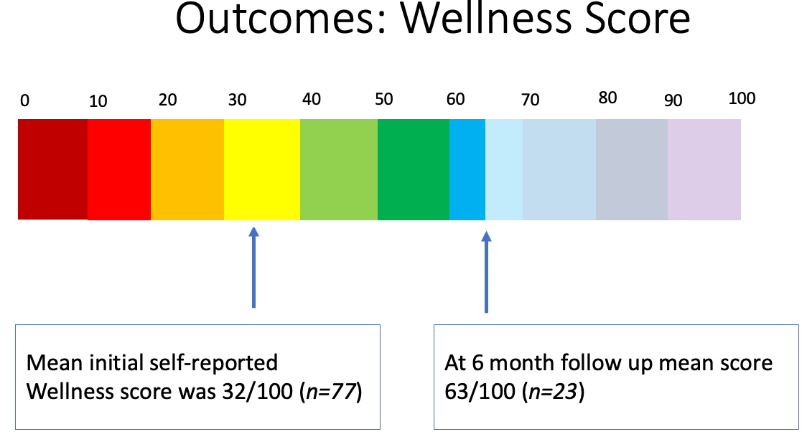
Outcomes
Pan London service - first 176 patients over 6 months
Improvement in symptoms and wellbeing was seen in over half of patients.
Functional impact score improved in 56%
School attendance improved in 64%
Wellness scores improved from mean of 32 to 63
Approx 1/3 of patients remained stuck
Notes:
Terry I may not go into all of this is that okay?
Sure - I will reduce or move this slide
Generally we found that there was a significant improvement in wellness score and school attendance after 6 months.
However approximately a third of patients remained stuck
To assess outcomes in more detail we next looked at school attendance
Next slide
Shown in the green bars on this graph you can see that at the initial assessment just 27% of patients were attending school full time or more than half the time whilst 72% of patients were attending school less than half the time or not at all reflecting the severity of our clinic cohort
At follow up those attending full time school had increased by almost five times from 8 to 39% whilst those out of school completely had reduced from 20 to 6%
Those attending school more than half the time had increased from 27 to 64%
Overalll 59% had improved school attendance at 6 month follow up. 27% of patients had no chang
Only 4 patients (<1%) had worsened attendance at 6 mo f/u
4/73 worsened attendance
20/73 no change in attendance
43/73 improved attendence
We categorized functional impact of Post Covid Syndrome based on the NICE ME/CFS severity score where those with mild functional impairment on daily activities would include young people who can care for themselves but may have stopped leisure activities due to their symptoms, while patients who have very severe impact are unable to get out of bed and are fully dependent on care
Here you can see the change in functional impairment from initial assessment to 6 month follow up
The x axis shows the functional impact score at initial assesment
Green shows at 6 months whether there is an improvement in functional score- those who have got better -
Blue shows those whose functional score has not changed
Red shows those that have got worse at 6 months
Next slide
Only 4% got worse and these were all in the mild group
In each group
Next slide
39% full time
25% more than half the time
64% imporved school attendance
30% no change
5% reduced

Slide 19



Impact of Post COVID
Keeping up with school work
Showering + ADL’S
Going out with friends
Climbing stairs
Concentrating
Walking
Sport and exercise
Participating in interests
Getting up for school
Getting to sleep
Symptoms worse after exertion
School
attendance
Notes:
The impact of Post‑COVID, affects every part of a young person’s life and extends to the whole family. Everyday activities that most young people take for granted can become difficult, and not being able to keep up with friends or take part in the same activities can leave them feeling left behind. That understandably has a significant impact on mood and emotional wellbeing.
Many of their challenges overlap and feed into each other. Some are managing to attend school, but that often uses all of their available energy, leaving nothing left for anything else.
Sleep is frequently disrupted, which makes mornings harder and affects school attendance.
Physical effort — such as walking or using the stairs — can increase symptoms, limiting involvement in sports, hobbies, and socialising.
As a result, many young people spend long periods on screens, often because they’re bored and don’t have the capacity to do much else.
This screen use commonly happens late at night, which further disrupts sleep, increases daytime fatigue, and leads to the need for daytime naps.
Over time, this reinforces an ongoing cycle of poor sleep, reduced activity, and persistent symptoms.

Slide 20

Principles of engagement
Key
Active Listening and hearing their journey
Validating reality of symptoms
Seeing the whole person
Keeping in mind psychological impact
Tips
Helping with tolerating uncertainty
Refocusing away from search for 'magic wand/ pill'
Setting realistic expectations
Therapeutic optimism. Help toward acceptance of current state while also holding on that this is temporary and will get better – with time
Help find ways to live according to values
Involve family/ friends
Notes:
For this cohort, the pathway to accessing appropriate support is often a long journey. By the time they reach specialist services, many report feeling distressed, not believed, and unsupported. It is common for trust in professionals to have been lost over time.
It is key to listen carefully to the young person’s journey, validating their symptoms, and recognising the pervasive impact of Post‑COVID across all areas of life is essential. Seeing the whole person and acknowledging the psychological and emotional impact of their lived experience, helps to establish therapeutic relationships and the setting of realistic, achievable expectations.
Ensure there is
Support for young people to tolerate uncertainty around their recovery
Gently refocusing away from a search for a “magic wand” or single treatment
Setting realistic, collaborative expectations
Maintaining therapeutic optimism: supporting acceptance of the current situation while holding hope that symptoms will improve over time
Helping young people find ways to live in line with their values, despite current limitations
Involving family and friends as part of the support system
This approach helps rebuild trust, supports engagement, and allows intervention to focus on meaningful, achievable change rather than symptom elimination alone.

Slide 21

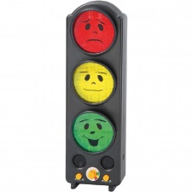
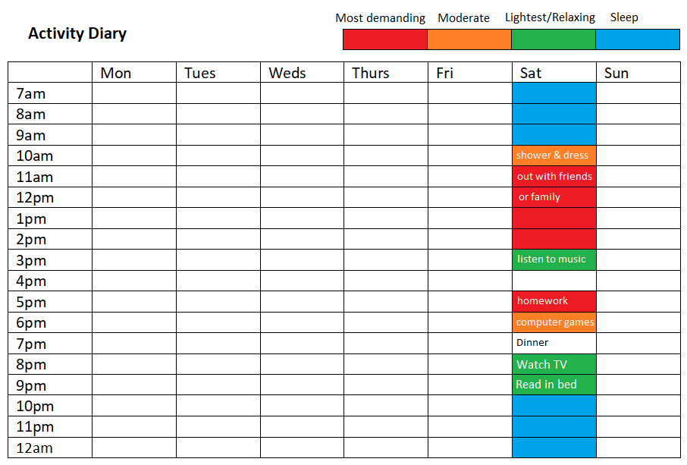
Rehabilitation for ME/CFS and Post COVID syndromeAssessment - Identifying rehab needs
Symptoms and functional challenges (autonomic symptoms)
Activity patterns
Interests, priorities, previous activity, what brings joy
Current daily routine: activities, school, screen time, meals
Wake, sleep times, naps
What do they want from rehab / personalised approach?
Identifying rehab goals
Notes:
Assessment plays a key role in identifying individual intervention needs. For some young people, the primary difficulty is getting into school at all. Others are able to attend, but only by using all of their available energy. They may then need to sleep when they get home or spend the entire weekend recovering, leaving no capacity for enjoyable activities or time with friends and family.
Through assessment, we can identify the factors that are reinforcing a boom–bust pattern of activity and contributing to symptom exacerbation. This includes exploring what the young person is currently able to do, what they enjoy, and how this compares with their previous level of activity.
We look closely at daily activity patterns, sleep routines, and both self‑imposed and external expectations.
Understanding what a typical day for them looks like — whether routines are established, whether there is daytime sleeping, what they feel they are missing, and what they would like to change — This helps us to identify meaningful goals, and provides a foundation for targeted, realistic intervention that supports function and quality of life.

Slide 22










Key foundations- focus for rehab
Day Light
Foundations
Education
Sleep
Daily activity, Fun and
Physical activity
Food & Drink
ThePhoto by PhotoAuthor is licensed under CCYYSA.
Family & Friends
Notes:
Intervention is multifactorial with focus on improving quality of life both in the present and when planning ahead.
Starting at the top on the slide . Daylight exposure is important, what is the quality of their sleep routine and sleep hygiene. Many will be heading towards a day night reversal at worse but will often stay awake into the night and sleep in the day. This can impact on meal times and their nutrition. Appetite and dietary intake are often affected, and early identification of nutritional concerns allows timely access to specialist support.
Education for young people and families is also key, for greater understanding and a supporting environment at home.
Looking at the activities in their day young people are supported to understand how different activities draw on different amounts of energy. High energy activity include physical, cognitive, and emotional demands. At first establishing a baseline amount of activity in their day means they can stop exacerbating symptoms and start to choose what they want to use their available energy on.
This includes activities they need to do, such as self‑care and education, as well as activities that are meaningful to them, like hobbies and seeing friends. Developing an awareness of available energy supports informed decision‑making, helping young people prioritise and ensure that enjoyable activities are included alongside essential ones. This is understanding energy management
Physical activity is particularly important for children and young people. However, activity must be carefully matched to the young person’s ability, taking into account their response to physical activity and severity of condition. The aim is to support stabilisation and gradual restoration of physical capacity without symptom exacerbation and avoiding overexertion. We use safe, individualised activity plans often based around functional tasks.
Education is frequently a significant source of stress, both for young people and their families. Early communication with schools and shared understanding of agreed plans and recommendations can make a substantial difference in enabling meaningful engagement with education.

Slide 23



Education
IHP, EHCP, IEP | Navigating exams | Moving on
School or parent to start process with support from health | Reduced number exams Change exam timetable eg Art A level spread over 5 days | 6th form & colleges are more flexible
Local council- google 'EHCP' | Reduce number of subjects | Preparing for university
Role of IPSEA to provide special education advice (IPSEA) Independent Provider of Special Education Advice | Extra time Rest breaks Scribe Reader Laptop Separate room | Consider accommodation needs Catered / non catered Transport Link with disability team at university
 | Alternative provision- home/other site | Application for Disability Student Allowance https://www.gov.uk
Referral to Bright Futures UK • Supporting Children & Young People Back Into Education After Long-Term Illness Connexions- county wide | Letter to support recommendations | Transition to adult support Letter to support
Possible solutions:
Flexible timetable
Reducing subjects
Rest breaks
Exit card
Skip the queue pass
Lift pass
Student support
Alternate provision:
Hybrid approach
On line lessons
Home education
AI bot
Notes:
This slide offers ways for early support in education.
Children and young people with Post‑COVID are estimated to lose an average of 20.6 hours of learning per week. Early liaison with schools or home education providers is crucial. An immediate letter outlining the need for a flexible timetable can significantly reduce anxiety and pressure for the young person, their family, and the school, and helps to set realistic expectations from the outset. Where appropriate, support with EHCP processes and educational adjustments can make a significant difference to engagement, anxiety, and longer‑term outcomes.

Slide 24



Pacing Toolbox
Spread out activities
Break up tasks
Stick to planned limits
Alternate physical and cognitive activity
Regulate sleep
Do gentle activity on a ‘worse’ day
Take regular rest breaks
Notes:
Strategies for managing day‑to‑day to help maintain their baseline activity level, are often described as a set of tools or techniques. These are used to help prevent symptom flare‑ups, or to reduce the impact of symptoms if they are triggered. The focus is on either reducing overall energy expenditure or spreading available energy more evenly across the day.
Common strategies include breaking activities into small, manageable chunks with regular rest breaks, alternating between different types of energy use — such as cognitive and physical activity — and working within planned limits. On more difficult days, this may also involve intentionally reducing activity to prevent further symptom exacerbation.
These strategies form part of a young person’s personal “toolbox” and can be drawn on flexibly, depending on symptoms, demands, and priorities on any given day.

Slide 25

Shared care
General paediatrician to remain
School letter re flexible timetable
Local
Refer to local physiotherapy
Consider mental health support eg CAMHS
Consider Neurodiversity referrals
Refer local OT
Disability safeguarding
Refer to specialist services
Notes:
Post‑COVID symptoms have become a longer‑term condition, and rapid improvement is unlikely.
Ongoing involvement from the local general paediatrician is therefore important to ensure continuity of care and timely support, particularly around emerging issues such as education.
Engagement with local services is also essential. This may include physiotherapy, occupational therapy, disability services, and where indicated, CAMHS or neurodiversity referrals.
Alongside local input, referral to specialist services should be considered. Some of these are national services and accept referrals from across the country. Specialist involvement supports ongoing follow‑through, the development of an individualised management plan, and helps equip young people and families with the tools and confidence to make informed, independent decisions about managing the condition over time.

Slide 26
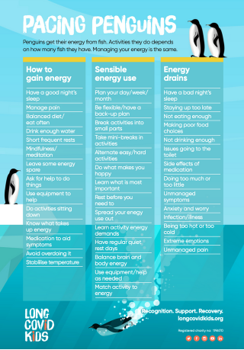
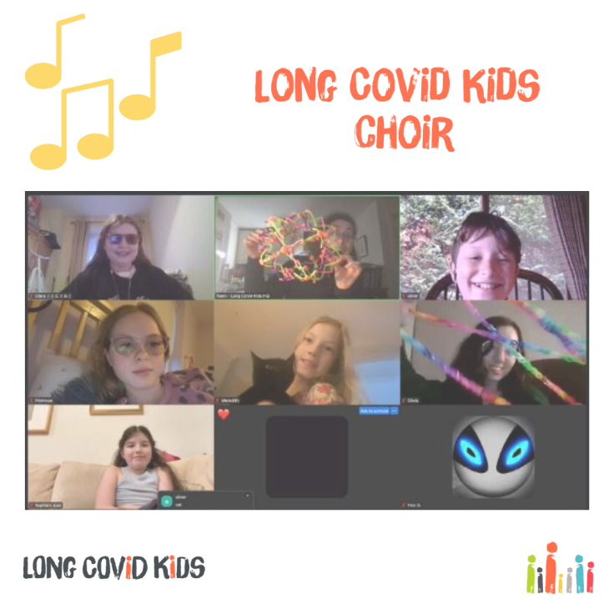
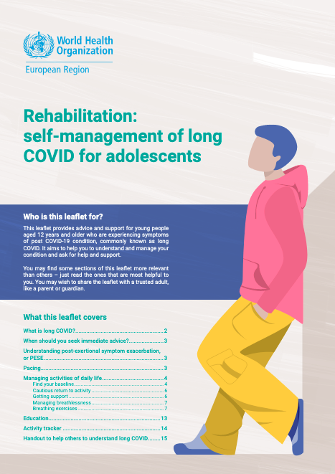


Rehab resources
Notes:
https://www.longcovidkids.org/educational-toolkit
https://www.longcovidkids.org/support-guide
https://www.longcovidkids.org/post/pacing-penguins-supporting-kids-living-with-long-covid-to-manage-their-energy
Ideally and when appropriate young people should be reviewed by a specialist service; however, early action has a significant positive impact. There are a number of resources available as seen here, alongside specialist service websites, which can support early management, education, and intervention while awaiting specialist input.

Slide 27
Setbacks and flare-ups
Can happen
Worsening of symptoms lasting a few days
Evaluate new symptoms
Agree self management strategies
Identify possible triggers
Temporarily reduce activity levels
Consider adjusting support level
Notes:
Setbacks and flare‑ups are common, and may occur without an obvious trigger. The resulting crash can range from a short‑term worsening of symptoms lasting a few days to a more significant regression that persists for longer. New symptoms may also emerge, so it is important to evaluate these carefully and always consider the possibility of additional co‑morbidities.
Developing skills to recognise triggers and manage flare‑ups is an important part of the management. As previously mentioned young people are supported to build a toolbox of strategies that can be selected and applied flexibly, depending on their symptoms and circumstances.
Periods of change — such as school transitions, exams, changes in home circumstances, or moving house — are common hotspots for setbacks. During these times, young people and their families may require increased support, reassurance and a temporary adjustment to expectations and management plans.

Slide 28
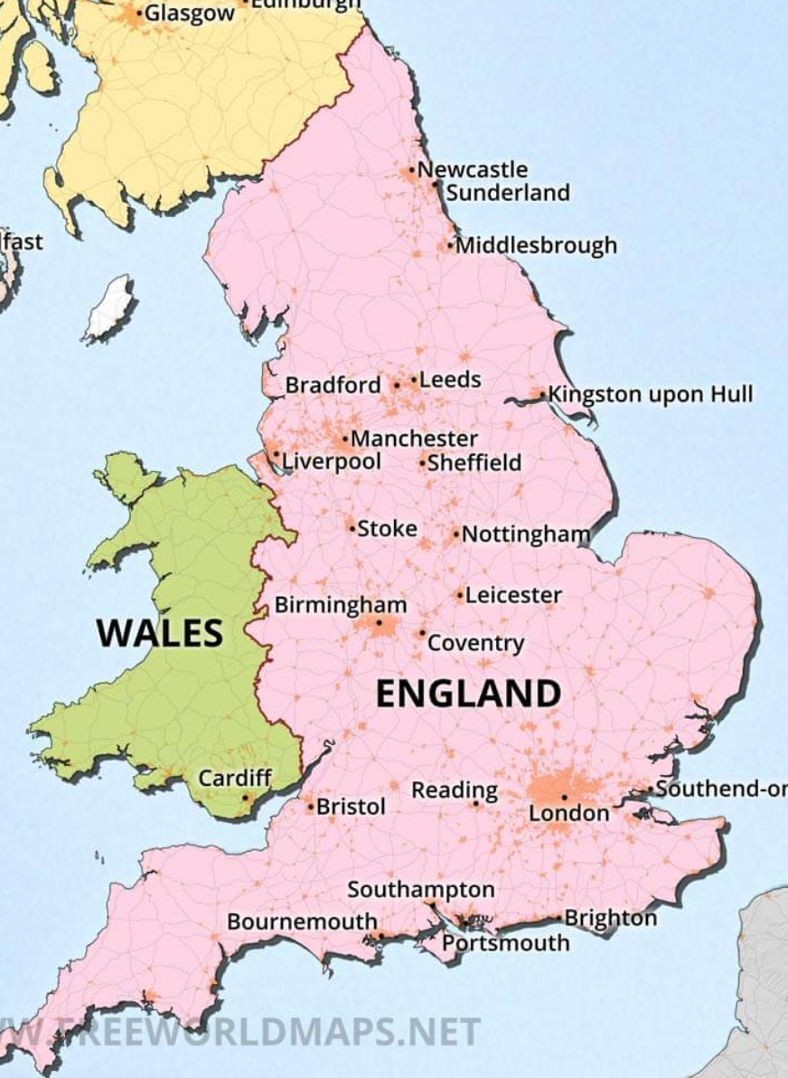
England CYP Long COVID services
Map of 10 clinics (Originally 15 commissioned July 2021 and 13 opened) Funded through ICBs- struggling to get service funding agreed and paid
Cambridge, Birmingham and Leicester LCS closed
Inequitable especially for severely affected
Long distances to travel
Approximately 2000 children and many more at GP and paediatric level
Still much unmet need
Notes:
This map shows 10 clinics in England seeing children and young people with Post‑COVID. Originally, 15 services were commissioned in July 2021, with 13 clinics opening, but several have since closed, including Cambridge, Birmingham, and Leicester.
Services are funded through ICBs, and many have faced ongoing challenges in securing sustained funding. This has resulted in inequitable access, particularly for severely affected young people, with some families required to travel long distances for specialist input.
Currently, approximately 2,000 children are known to specialist services, with many more being managed at GP and general paediatric level. Despite this, there remains significant unmet need across the country.
Unfortunately a recent update of the map reveals two more closures and two further services unsure of continuation after March 2026

Slide 29

Summary update
Post COVID syndrome can be a debilitating condition
It is present and often unseen due to lack of testing
Important to take these symptoms seriously and believe
Early recognition and management is key to supporting
Providing good quality assessment and management of symptoms and comorbidities , rehab and support for young people and families is crucial
The aetiology is becoming better understood but evidence base for medication for CYP is lacking
The time course of long COVID and proportion of patients who will recover or have long-term symptoms is unknown
Future funding for clinical services and Research needed.
Notes:
Take home messages…..
Post‑COVID syndrome in children and young people can be debilitating and profoundly life‑changing, yet is increasingly hidden now that routine testing has gone.
Early recognition, good‑quality assessment, and holistic intervention are essential.
While pharmacological evidence in this group remains limited, specialist‑led interventions and structured programmes clearly play an important role.
We still don’t fully understand the scale of long‑term need, which highlights the importance of continued research and appropriate service funding to ensure young people and their families can access the support they need.
Finally, I’d like to highlight the IPIC conference taking place at the end of March. Formerly the Post‑COVID Society, IPIC — the International Post‑COVID and Post‑Infection Conditions Society — is part of BSPRM and is hosting a dedicated day focused on education, discussion, and ideas for supporting ongoing services and would be grateful for your support.

Slide 30
Thank you for your attention
Please see slides below for further detail
We can answer questions in the panel session later
https://www.uclh.nhs.uk/our-services/find-service/children-and-young-peoples-services/post-covid-service-children-and-young-people
Acknowledgements
Pan London CYP Post COVID Service clinicians and patients
Melissa Heightman, Toby Hillman – adult respiratory physicians Post COVID Lead
NHSE, NHS London
BACME Board
TRACCS team
Dr Vikki McKeever
Professor Lesley Kavi, PoTS UK
Young people with Post COVID/ ME/CFS and PoTS in our care at UCLH and their families
Post COVID society
Danilo Buonsenso and Rome group
Long COVID kids
Notes:
Just to note there are a number of additional slides attached to this presentation, for further perusal of information.

Slide 31







Acknowledgments/resources
Pan London CYP Post COVID Service
Dr Liz Whittaker( Imperial), Dr Ben Baig Dr Nathalie McDermott( Evelina London), Dr Lizzie Wortley, Jennifer Balcomb, Julia Hopkins
Anna Gregorowski, Deborah Woodman, Petra Mohr, Abi Davison Jenkins
Monica Samuel, Jenny McClure and Mdteams, Sam Sonnoppa, respiratory paediatrician
Becky Johnston, Hannah
Melissa Heightman, Toby Hillman – adult respiratory physicians Post COVID Lead
NHSE, NHS London Zara Brookes
BACME Board
TRACCS team
Dr Vikki McKeever
Professor Lesley Kavi, PoTS UK
Young people with Post COVID/ ME/CFS and PoTS in our care at UCLH and their families
Post COVID society
Danilo Buonsenso and Rome group
Long COVID kids
Notes:
Groups

Slide 32
Resources and references
https://www.uclh.nhs.uk/our-services/find-service/children-and-young-peoples-services/post-covid-service-children-and-young-people
Dysfunctional Breathing:
Physiotherapy for breathing pattern disorders resources for physiotherapists (physiotherapyforbpd.org.uk)
Physiotherapy in the management of teenagers and young adults with asthma and altered breathing patterns | Royal Brompton & Harefield hospitals (rbht.nhs.uk)
Chronic Pain
Conquering Your Child's Chronic Pain: A Pediatrician's Guide for Reclaiming a Normal Childhood : Zeltzer, Lonnie, Schlank, Christina Blackett: Amazon.co.uk: Books
Managing Your Child's Chronic Pain : Palermo, Tonya M., Law, Emily F.: Amazon.co.uk: Books
Pain is Really Strange : Steve Haines. Art by Sophie Standing.: Amazon.co.uk: Books
NICE Guideline for ME/CFS: www.nice.org.uk/guidance/ng206
BACME www.bacme.info
Action for ME
WHO rehabilitation leaflet
Accessing Education
Government website: Children with special educational needs and disabilities (SEND): Extra help - GOV.UK
Scope: Applying for an EHCP | Disability charity Scope UK
IPSEA (special education advice): (IPSEA) Independent Provider of Special Education Advice
Long COVID Kids: Educational Toolkit | Long Covid Kids
Bright Futures:
Dysautonomia
www.potsuk.org
Dysautonomia International Video library: https://vimeo.com/dysautonomia
www.thedysautonomiaproject.org American website about dysautonomia conditions
YouTube videos- Dr Gupta York Cardiology, POTS/Dysautonomia
https://www.youtube.com/watch?v=5J4-3QsPDuw
www.dysautonomiainternational.org

Slide 33
References: ME/CFS
NICE Guideline for ME/CFS: www.nice.org.uk/guidance/ng206
NICE guidance on ME/CFS for patients/public: www.nice.org.uk/guidance/ng206/informationforpublic
BACME www.bacme.info
An introduction to Dysregulation in ME/CFS
Post Exertional Malaise
ME/CFS Symptom management guide
ME/CFS Guide to Therapy
Primary Care Guide to ME/CFS
Post-viral fatigue guideline (available in several languages)
Patient support charities:
Action for ME (adult and children/young people): www.actionforme.org.uk
ME association: www.meassociation.org.uk
Autonomic Dysfunction
www.potsuk.org
Dysautonomia International Video library: https://vimeo.com/dysautonomia
www.thedysautonomiaproject.org American website about dysautonomia conditions
YouTube videos- Dr Gupta York Cardiology, POTS/Dysautonomia
https://www.youtube.com/watch?v=5J4-3QsPDuw
www.dysautonomiainternational.org
Hypermobility
www.hypermobility.org
RCGP Ehlers Danlos Syndromes Toolkit: https://www.rcgp.org.uk/clinical-and-research/resources/toolkits/ehlers-danlos-syndromes-toolkit.aspx
Mast Cell Activation Syndrome (MCAS)
Mast Cell Action https://www.mastcellaction.org/
Also information available in the RCGP Ehlers Danlos toolkit in the ‘emerging major associations’ section
British Dietetic Association https://www.bda.uk.com/
provides basic dietary advice on a wide range of subjects including a food fact leaflet for ME/CFS and various food intolerances/allergies and info on low histamine diets.
Patient Communication aids
Stickman Communications: https://stickmancommunications.co.uk/

Slide 34
SYMPTOM/ISSUE | DRUG/TREATMENT | EVIDENCE | Safe????
Fatigue, post exertional malaise brain fog | Pacing (cognitive and physical) | Yes, effective | yes
POTS | Salt 5g/day, 2.5L water, compression stocking | From MECFS/POTS literature, effective for some | Definitely
 | B blockers, fludrocortisone, midodrine, ivabradine | From MECFS/POTS literature, effective for some | Usually
Immune dysfunction | IVIG | MECFS Literature, can be | Risk benefit
Fatigue, low mood | Low dose aripiprazole SSRIs | MECFS literature
Generalised | Low dose naltrexone | Anecdotal | Probably but unknown
Abnormal clotting | Triple anticoagulation | Mixed | Almost certainly not
Viral persistence | Known antivirals valaciclovir, acyclovir etc | None so far | Usually
 | Paxlovid | None so far | Not known
GI symptoms
MCAS (rashes/ GI symptoms) | H1 + H2 block – famotidine + cetirizine | In adults, effective | Yes probably
Others | Vagal nerve stimulation, plasmaphoresis, Pycnogenol, sulodexide | None | Not known

Slide 35

Energy management
Self directed
Give knowledge
Be open
Find baseline
Help them plan – include all types of exertion (mental, physical, social, emotional, ADLs etc)
If want to do more than ADLs, need physio or OT

Slide 36
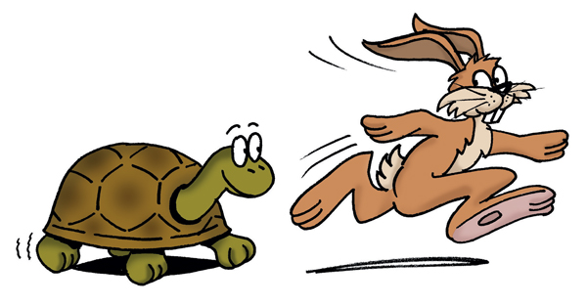



Increasing Activity
No one size fits all, personalised approach
Start with lower intensity activities from manageable baseline.
When symptoms stable, very small flexible increases
Review and adjust as needed.
Start low, go slow !
Little and often principle
Consistency
Notes:
Low intensity activity – stretches, gentle mobility, easy cognitive task, audiobook,
Activity Physical, cognitive, social, emotional
Physical activity includes functional activity – getting dressed, brushing teeth, sitting up, functional meaningful activities
Not using HR monitor but could do if it will be helpful
Symptom contingent titration

Slide 37

Education
Pressure and worry about education common
Support from OT /nursing/ teachers
Gradual return to school, reduced timetable, later lessons, social time
Extra support / adjustments / online
Physical aspects of school (commute, stairs etc.)
Liaise with school
Notes:
Leave PE until ready and able to do vigorous activity, then start with just the warm up, short time
Return to full time school common goal
Some Patients have had to take a year out or retake a year
Preparation for university

Slide 38
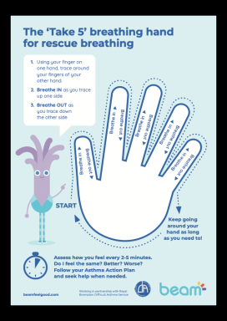
Breathlessness / chest pain / palpitations
Screening for other causes
Triggers / patterns: on exercise or rest?
BPAT Brompton Breathing Pattern Assessment Tool, Pattern, rate, noise, nose / mouth
Cognitions / attributions
Treatment:
Education
Relaxation + thoracic mobility + posture
Breathing pattern training, ‘slow, low, nose’
At rest and exercise
https://www.physiotherapyforbpd.org.uk + brompton resources
Notes:
Screening – xray, desaturation, CT chest, exercise tests such as CPET (cardio pulmonary exercise testing) 24 hour tape
Importance of nose breathing
Nijmegen questionnaire not very specific in LC
BPAT above 4 indicative of BPD
SEBQ – self evaluation of breathing questionairre

Slide 39
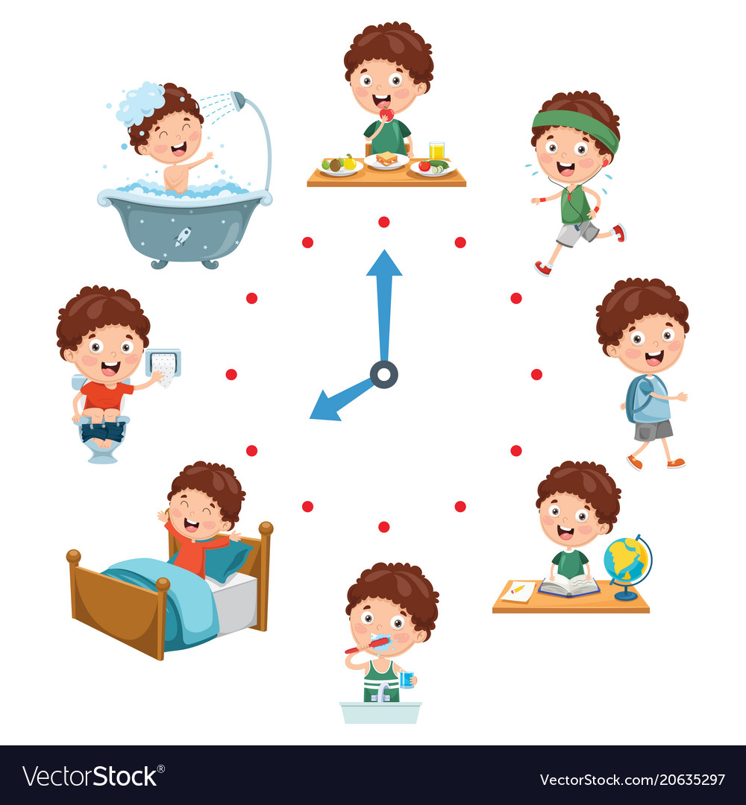
Sleep: consistency is key
https://www.evelinalondon.nhs.uk/our-services/hospital/sleep-medicine-department/how-to-sleep-well-for-teenagers.aspx
Meal times
“Natural” light during the day
Physical activity
Daily rituals
Wake-up time
Screen-time
Bedroom environment
Bed-time
Pre-bed time “wind-down” routine

Slide 40
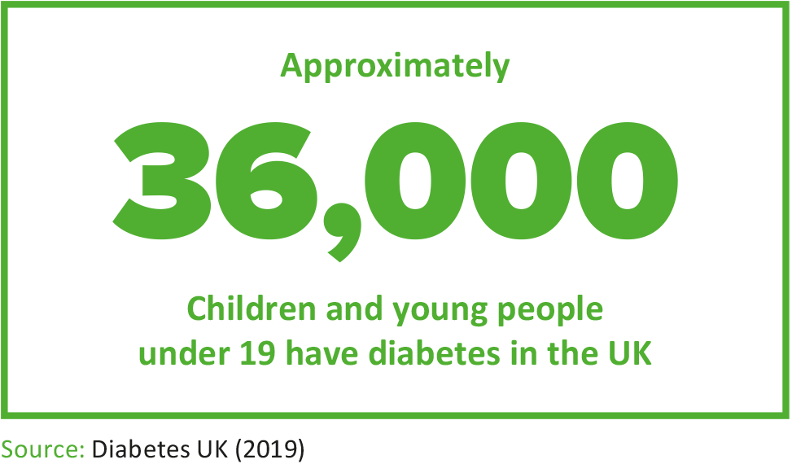
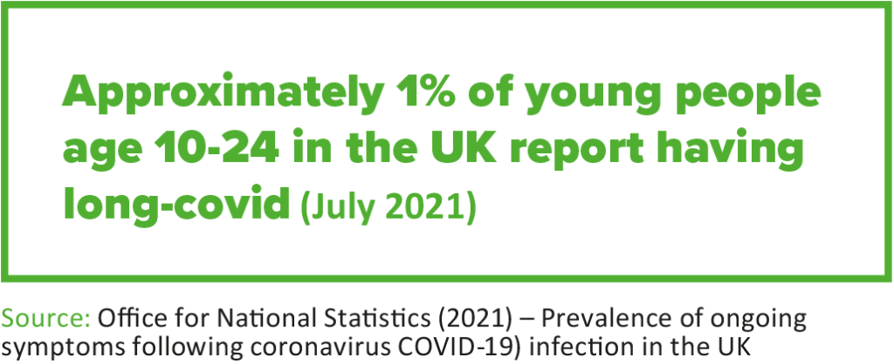
How big is the problem??
14 million < 18 in the UK
ME/CFS = 1/200
Long covid ? 1- 40% in various studies up to 2023…. Now?
Collin SM et al (2016) Chronic fatigue syndrome at age 16 years. Pediatrics. 137:e20153434
Stephenson T et al. Long COVID - the physical and mental health of children and non-hospitalised young people 3 months after SARS-CoV-2 infection; a national matched cohort study (The CLoCk) Study. 2021 doi: 10.21203/rs.3.rs-798316/v1

