Slide 1


RCPCH Grand Round 6/2/26 - Long Covid in Children and Young People
Long Covid Kids - Learning from Lived Experience:
Working in Partnership with Children and Families
Kirsty Stanley
LCK Health Lead and Occupational Therapist
kstanley@longcovidkids.org
Notes:
Intro

Slide 2
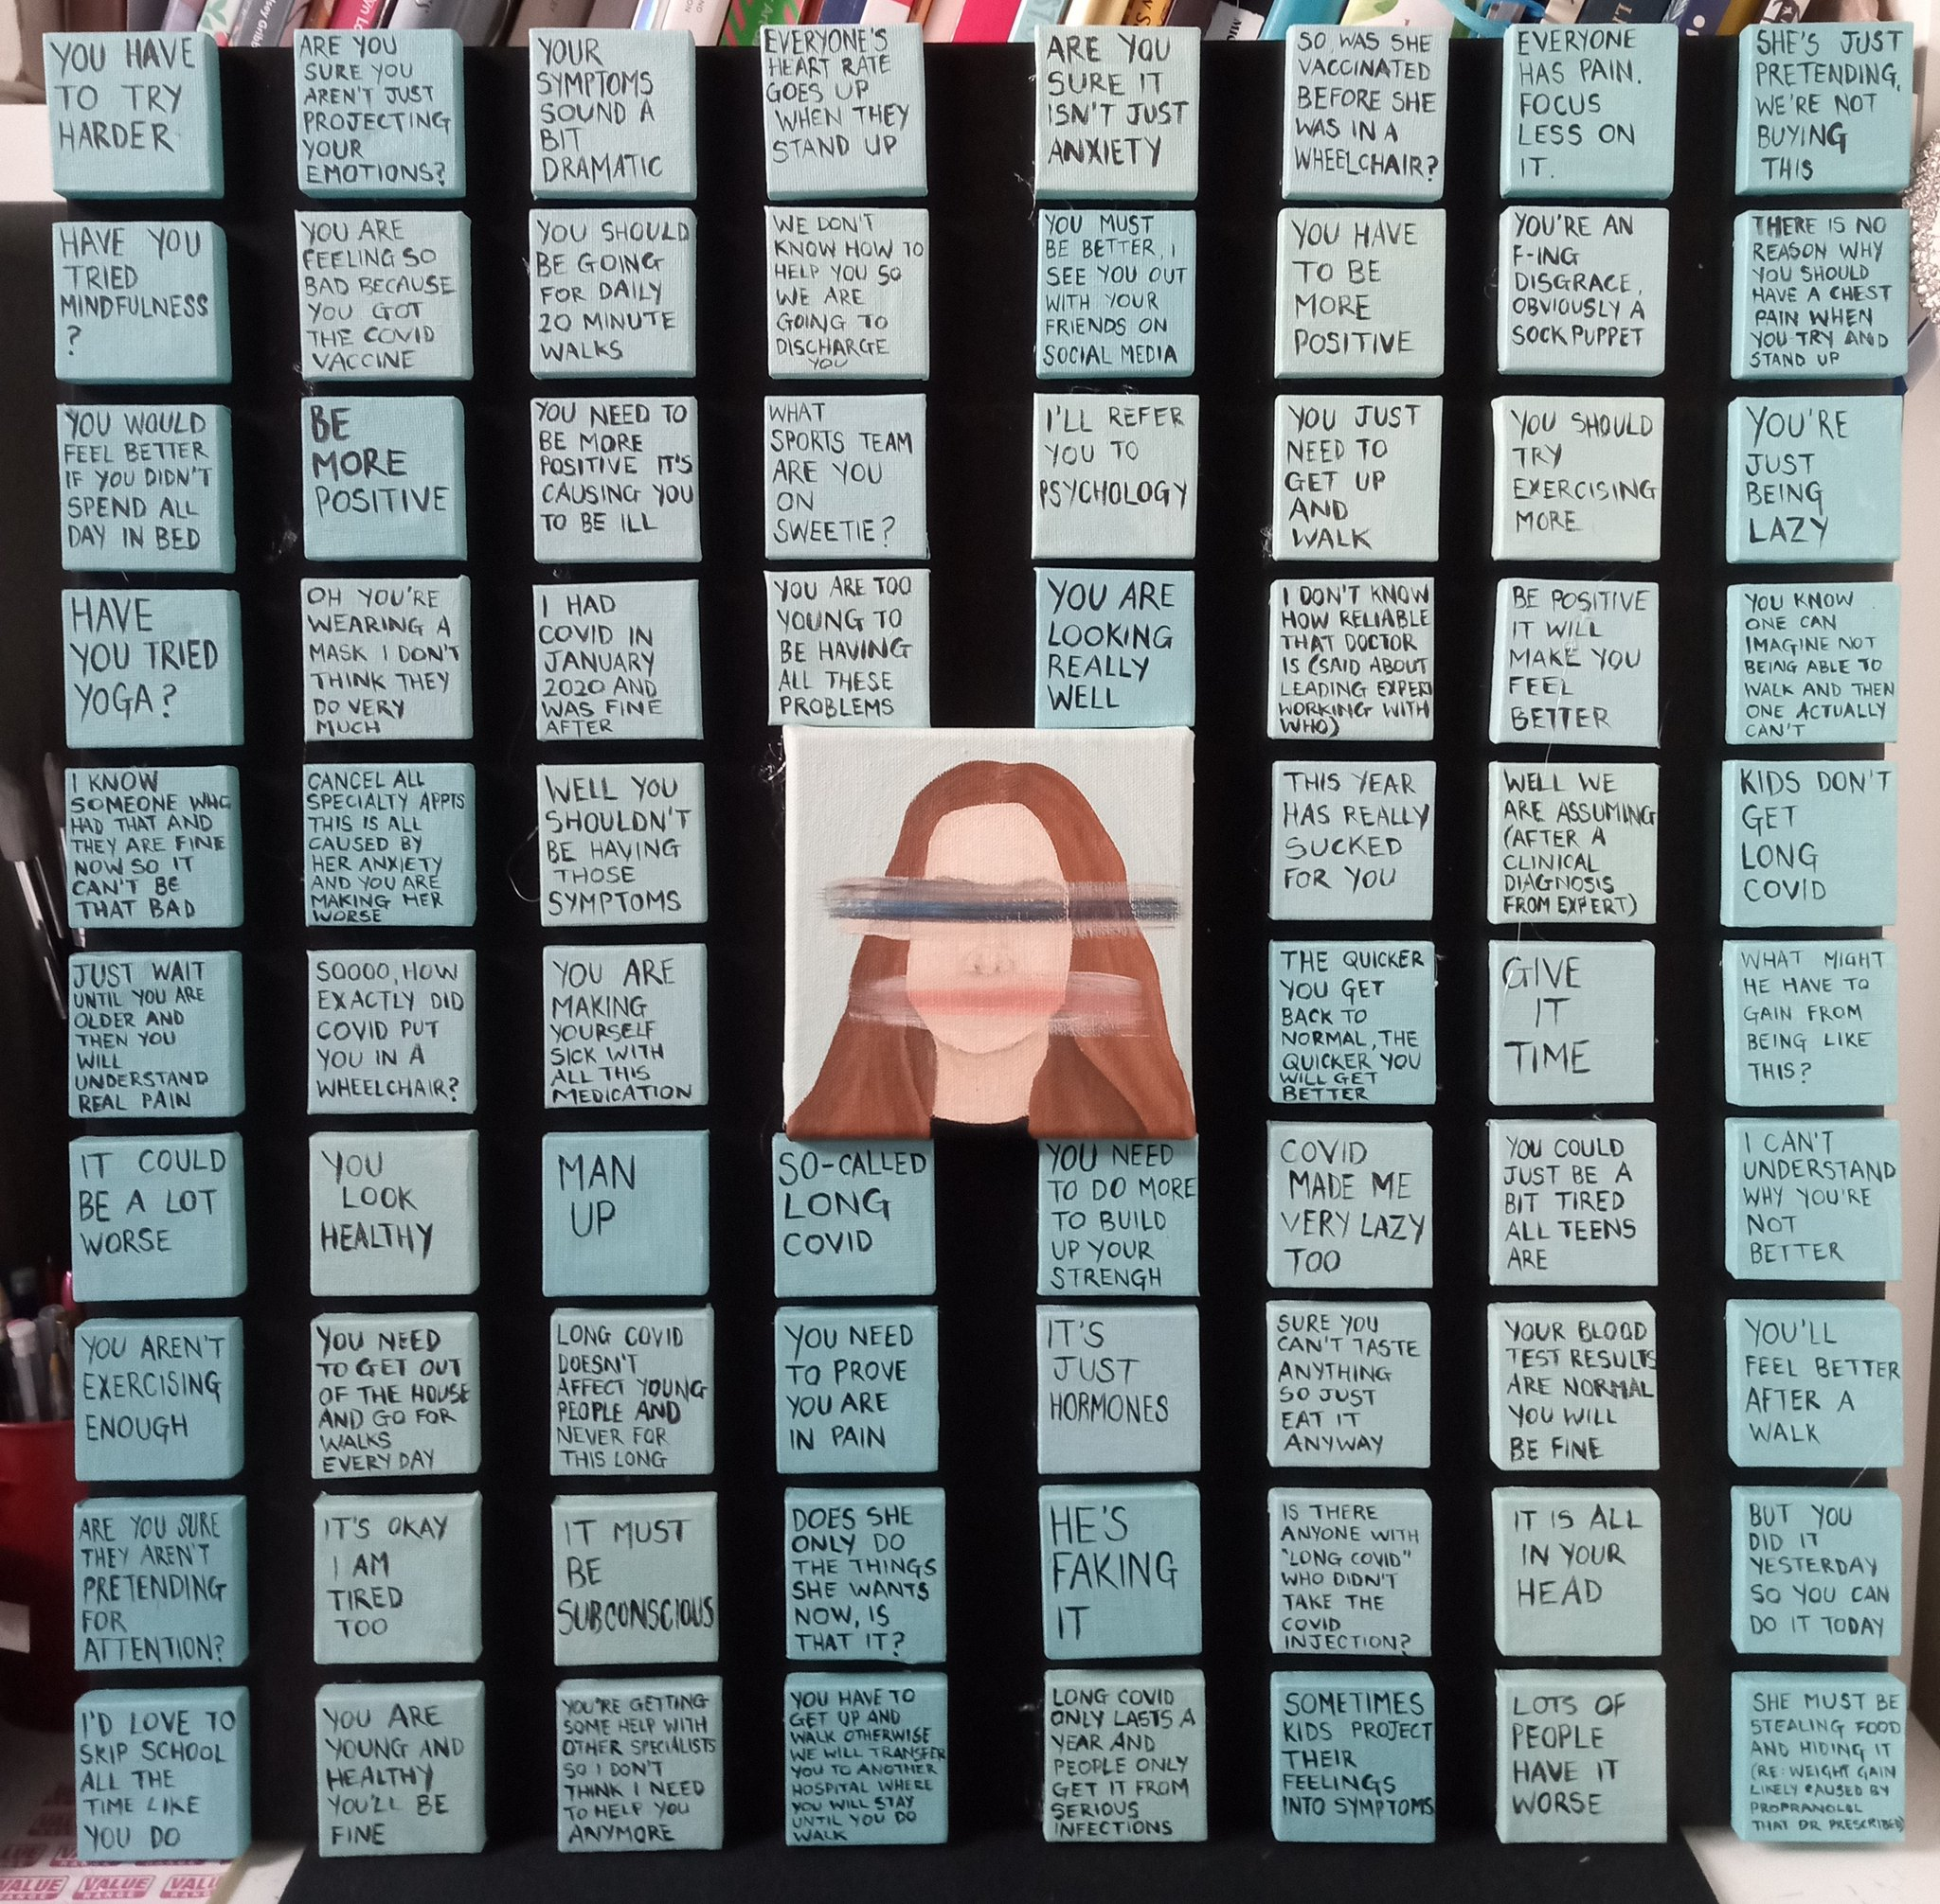

Artwork by Rosie Pidgeon LCK Member - Words from LCK Members

Slide 3


Improving Health Experiences
Notes:
Appreciate the health and education experiences of children, young people and families

Slide 4
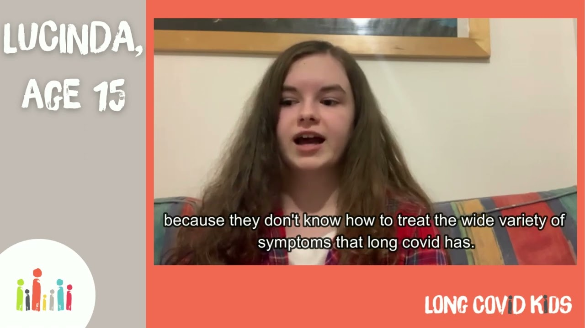
Notes:
50% of CYP who received support from healthcare settings were ‘very dissatisfied’ or ‘dissatisfied’ with the level of care they received.
72.8% highlighted their experience has not met their expectations with
66.4% For those referrals that have been made the average waiting time for this to occur is more than six months for 66.4% of CYP.
42% of those that have been referred to a Long COVID service are either unsatisfied or very unsatisfied with their experience.

Slide 5
Trauma Informed Care
Early experiences of healthcare for those with Long Covid have not always been positive - some children and families have medical trauma as a result
Long Covid is still seen as ‘The Elephant in the Room’ for a population that want to forget the pandemic - don’t ignore it
Focus on Safety and Dignity, Aim to Reduce Fear and Foster Trust
Informed Consent
Informed Opinion
Acknowledge your own knowledge and service limitations
Notes:
Further links to published research available on the final slides

Slide 6
Collaborative and Partnership Care
The child/young person and their parent/caregiver should be at the centre of their care.
Recognise that families may have accessed/be accessing private care and support - approach with curiosity and with a view to appropriate collaboration/communication.
Recognise and value the research that families bring to share - show curiosity and support their understanding.
Be non-judgemental when acknowledging or identifying risks and explain any concerns.
Consider who else it would be beneficial to involve.
Notes:
Further links to published research available on the final slides

Slide 7

Supporting the COVID Conscious
Being COVID Conscious is not anxiety, instead it should be viewed as informed risk management (that has often stemmed from the severity of Long Covid or impact of reinfection/s)
Some families will feel unsafe attending appointments where staff are unmasked - please consider mitigation measures such as Clean Air and Masking.

Slide 8

Setting Appropriate Expectations
Notes:
Understand what CYP&F are expecting from services in order to set appropriate expectations and facilitate referral on to other services as needed

Slide 9
Assess (for safe input)
Rule in/out
Treat what you can
Keep avenues for testing open - there may be a delay in tests showing issues
Early Advice and Signposting
With Long Covid you may need to support
“Pulling Back to Move Forward”
Work collaboratively with private services
Biological
Don’t conflate cause and consequence
Foster hope but support acceptance of the stage they are at
Empower the child and family - equal partnership and respect
There is a risk that too much focus on MH will create disengagement
=
Pressure from school - attendance vs health
Lack of understanding from peers
Impact on wider family
Inequitable access to healthcare and Support - particularly for minoritised groups
Access to benefits
Psychological
Social
Notes:
51% of those using private healthcare or looking abroad for treatment options.
The Biopsychosocial model has sadly developed a negative reputation in Long Covid circles. Because families perceive that how it is being used focuses only on the psychological where we need to consider these three areas equally.

Slide 10
Self-Care
Adequate Symptom Management - families know there is not a cure.
Families also know that there are common co-morbidities that should be explored and that may have effective interventions or guidelines to follow.
SLEEP, NUTRITION, PERSONAL CARE
Consider equipment provision (e.g. shower stools, ambulatory wheelchair use) and adapting occupations to conserve energy and support participation.
Refer for Social Care Support if needed - parents - some will have had to give up work to provide care - should receive a carers assessment.
Notes:
Further links to published research available on the final slides

Slide 11
Common Comorbidities/Symptom Clusters
ME/CFS - Fatigue, brain fog, PESE
PoTS - Dizziness, Fainting, Nausea
MCAS - Allergies and rashes, headaches, hoarse voice etc.
PANS - Neuropsychiatric symptoms inc tics, behavioural regression, eating disorders
The “controversy” of Anxiety and Depression
The Impact of Hormones
Hypermobility, Connective Tissue Disorders and Neurodivergence
Notes:
Further links to published research available on the final slides

Slide 12
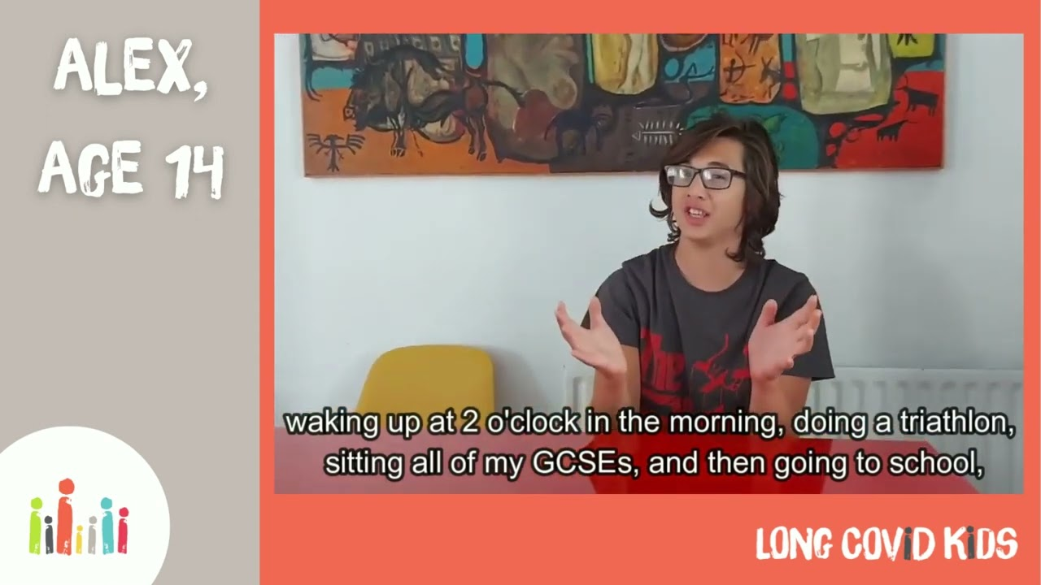

Slide 13
Post Exertional
Symptom Exacerbation
Fatigue
Exhaustion
Severity, Plateau
and Deterioration
Energy Limitation
Notes:
Fatigue affects almost all children and along with PESE and cognitive impairment is the most common symptom preventing participation in daily life. Multiple symptoms - combination is contributor.

Slide 14
Education
Education ≠ School
Adequate rest and recuperation
Cognitive support
Gradual, slow, paced and sustained return should consider hybrid, flexible and home learning options - plan needs to be agreed with child, family and school and flexible enough to support the condition’s variability
If there is an extended period of time where they cannot sustain full time then consider supporting EHCP application (although SEND provision is currently in review)
Educational Toolkit - designed for schools/educators but equally relevant to health/social care
/.
Notes:
EHCP applies to children with long term conditions too and provides support up to the age of 25 if needed with both aspects of education and independent living skills

Slide 15
Leisure
Children and young people need time to play, have fun, take part in hobbies and spend time with friends and family. This is essential to health and wellbeing.
Let’s not uphold a system only focuses on school to the detriment of the rest of their lives.
71% did not take part in any extracurricular activities now
Many have lost friendships
We need to recognise how children’s leisure occupations have changed - especially since the pandemic.
Online friendships are valid.
Gaming, TV, Socials, are lifelines.
Peer support from others with Long Covid can be helpful - but not for all.
Children want to be included, give advice to schools on how friends can keep in touch in healthy ways.

Slide 16


Slide 17
Disability & Benefits
“The letter from the long covid clinic said x is over doing it - hence fatigue. They came to this conclusion after asking x to do a standing/sitting test which x tried really hard on for 30 seconds”
- We scored 0 across everything.
Consider how your documentation will be used to support or deny claims for benefits e.g. DLA/PIP and devolved equivalents
Make appropriate conclusions relative to the level of assessment/intervention undertaken.
If there is uncertainty - be clear that this exists.
DISABILITY IS NOT A DIRTY WORD

Slide 18
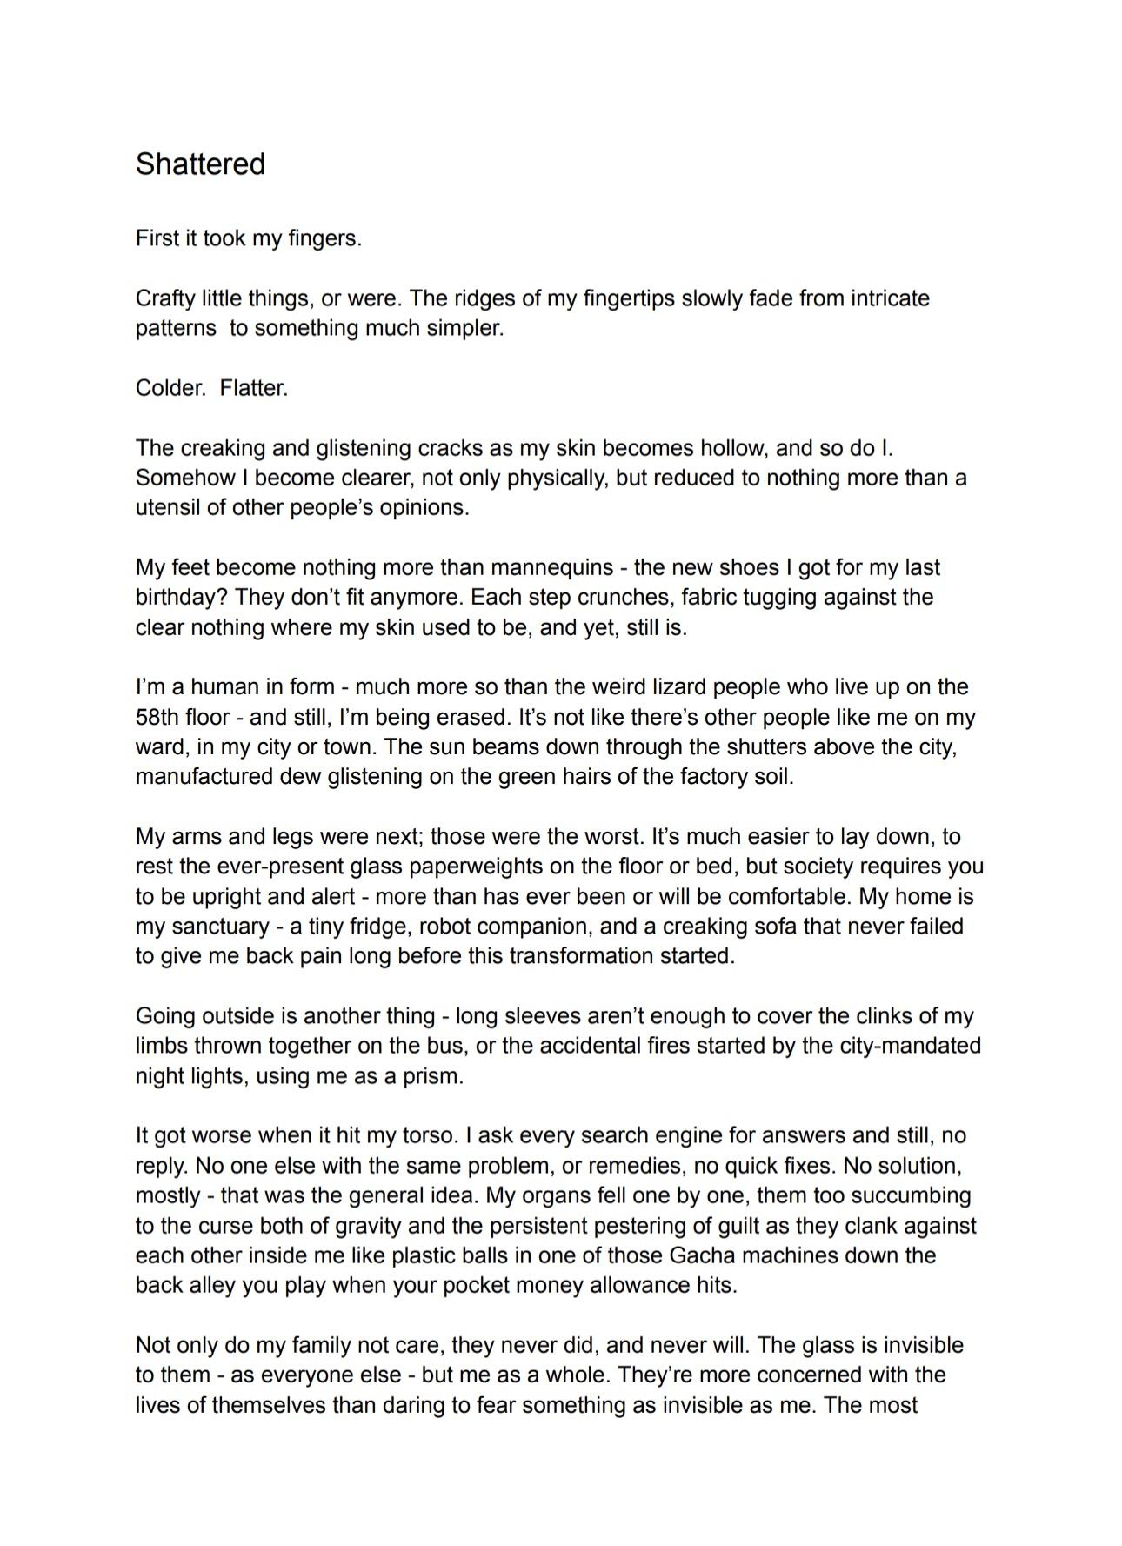
An Extract from
Shattered
by Lucinda Leal (now 18)
Please see this post on the co-produced Long Covid STARS research project and read and view the individual creative contributions

Slide 19
How Long Covid Kids Can Help…
Notes:
Be aware of and signpost to Long Covid Kids Resources and Support Services

Slide 20

…Health Professionals and Researchers
Long Covid Kids charity exists to make sure that children and young people’s voices - and those of their parents and caregivers - are heard, respected, and acted upon at every level of decision-making.
Through our Charity Team, Youth Advisory Panel (YAP), and Parents and Caregivers Advisory Panel (PCAP), we work in partnership with researchers, commissioners, and service providers to deliver insight rooted in lived experience.
We prioritise projects that:
Are genuinely co-produced, not tokenistic
Centre people living with Long Covid as experts in their own lives
Proactively address barriers to inclusion.
Fairly compensate contributors for their time, skills, and insight
This is not consultation for compliance — it is collaboration for change.
Read more about Co-Production values and practice
LCK biannual professionals’ newsletter (sign up on the link at the bottom of the page)
Long Covid Kids Collates a list of Relevant Research here
You can find our Blog here
info@longcovidkids.org
E-mail address for general enquiries
Notes:
How children describe these symptoms?.
We asked children to tell us about Long Covid, When talking about extreme fatigue children said-
It is like someone is pushing me down all the time
It is like I have run out of battery
When I wake up, I feel like I haven’t slept at all
My head feels heavy like I can’t really support it
I feel like an outside observer of my life, completely disconnected
When we delved more into the symptoms of brain fog, children told us:
It’s like my mind is white walls, white ceilings, just blank, like there's nothing in there
It's like having no clue of anything, even not being able to think
My brain is broken
It’s all fuzzy
My brain is like treacle
Trying to turn my brain cogs is exhausting, it’s like riding a rusty bicycle
CLICK
Long Covid is increasingly being referred to as a systemic thrombotic vasculitis disease that can cause multi organ hypoxia.
I will share the observations from our support services.
We have the privilege of supporting 10,000 families. We observe new onset seizures, nerve pain, mobility issues, regression, nurophysciatric issues, changes in hearing and vision, altered eating habits, insomnia, cognitive issues affecting memory and communication. The list goes on.
We are working with an international team on the Core Outcome Sets for Long Covid in children lead by Dr Daniel Munblit. We hope this will be available by early spring. I am supporting the WHO are currently working on a clinical definition that we hope will be announced late Autumn.
CLICK

Slide 21



…Children, Young People and Families
For Children/Young People
LCK Connected Teens (13+) (weekly zoom - chat and games - led by members of our Youth Advisory Panel)
LCK Connected 6-12 (bi-weekly zooms - chat and games - led by members of our Youth Advisory Panel)
LCK Choir (All Ages)(weekly zoom sing along)
Discord Server for chat, connection and support (13+)
Newsletter - The Long Covid Chronic-ill
NEW - Monthly Book Group
NEW - #AtOurPace - Blog Project
COMING - Hear Our Voices Podcast
For Parents/Caregivers
LCK Connected Parents and Caregivers (bimonthly zooms which either focus on peer support for parents of children/young people with varying presentations of Long Covid; or on Education, e.g. EHCPs, Benefits)
Facebook Support Group
Notes:
How children describe these symptoms?.
We asked children to tell us about Long Covid, When talking about extreme fatigue children said-
It is like someone is pushing me down all the time
It is like I have run out of battery
When I wake up, I feel like I haven’t slept at all
My head feels heavy like I can’t really support it
I feel like an outside observer of my life, completely disconnected
When we delved more into the symptoms of brain fog, children told us:
It’s like my mind is white walls, white ceilings, just blank, like there's nothing in there
It's like having no clue of anything, even not being able to think
My brain is broken
It’s all fuzzy
My brain is like treacle
Trying to turn my brain cogs is exhausting, it’s like riding a rusty bicycle
CLICK
Long Covid is increasingly being referred to as a systemic thrombotic vasculitis disease that can cause multi organ hypoxia.
I will share the observations from our support services.
We have the privilege of supporting 10,000 families. We observe new onset seizures, nerve pain, mobility issues, regression, nurophysciatric issues, changes in hearing and vision, altered eating habits, insomnia, cognitive issues affecting memory and communication. The list goes on.
We are working with an international team on the Core Outcome Sets for Long Covid in children lead by Dr Daniel Munblit. We hope this will be available by early spring. I am supporting the WHO are currently working on a clinical definition that we hope will be announced late Autumn.
CLICK

