Slide 1
Long covid and the CNS: a very short introduction
Emma Weisblatt
Paediatric Neuropsychiatrist
RCPCH Long Covid Webinar 6th February 2026

Slide 2
Paediatric liaison psychiatry – the usual model
Long-term “physical” illness in children is known to be statistically associated with “mental health”, neurological and developmental symptoms.
Liaison psychiatry covers A, B and C – eg cancer, epilepsy, brain injury. Much covid research does this. But the clinical discourse mostly does not.
A
Illness and treatment
CNS and psychiatric symptoms
B
Stress, isolation loss (Life Events)
C

Slide 3




The Great (Clinical) Silence on Covid
A
Covid infection and LC
Neuropsych symptoms
“all anxiety”
B
Stress, isolation loss (Life Events)
C
The political, economic, epistemic, cognitive and professional underpinnings for this are beyond the scope of this talk.
Today I aim to redress the balance and put the brain effects of covid itself back into the picture.

Slide 4
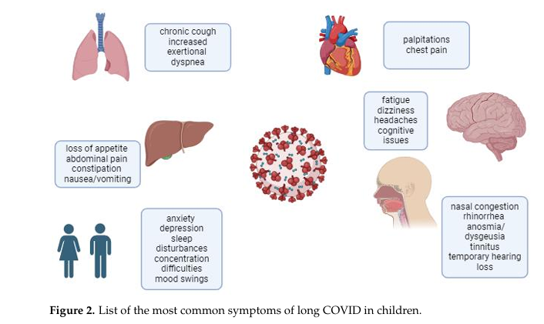
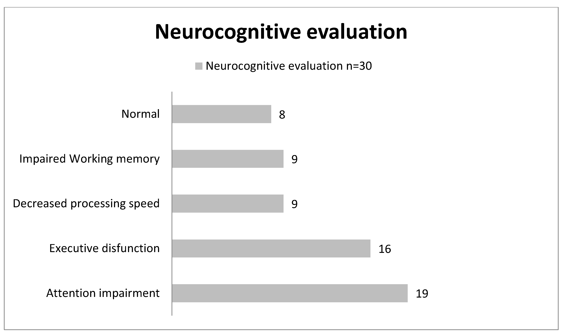



Covid and the brain: clinical symptoms in children
Basaca et al 2025 review of commonest clinical symptoms (out of 200+) consistently seen in children (Fig 2) - split across “systems”
Koterba et al 2023 review have found greatest cognitive impact in sustained attention, executive function, processing speed and working memory symptoms
Gonzales-Aumatell et al 2022 found attention and executive function impairments in majority of children tested in a long covid clinic
Gross et al 2024 from the RECOVER study identified symptom clusters in children and adolescents including cognitive and sensory symptoms
Many studies document an increase in relevant symptoms in children (such as tics, anxiety or depression) but consider them exclusively stress-related or pandemic life-event related.
Lack of studies of brain function, biomarkers and objective cognition in children rather than over 18s

Slide 5

A child has ONE experience of symptoms not 4
SYSTEMIC
COGNITIVE
MENTAL
NEUROLOGICAL
So, what is the impact of SARS-2 itself on the brain?

Slide 6
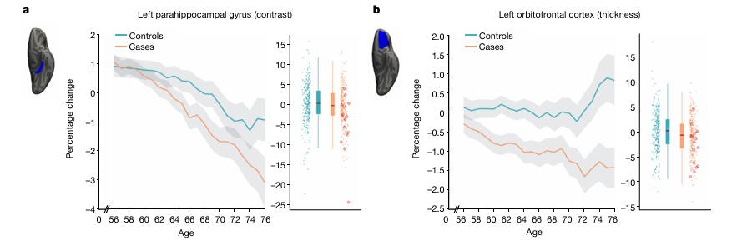
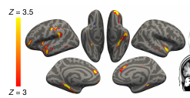
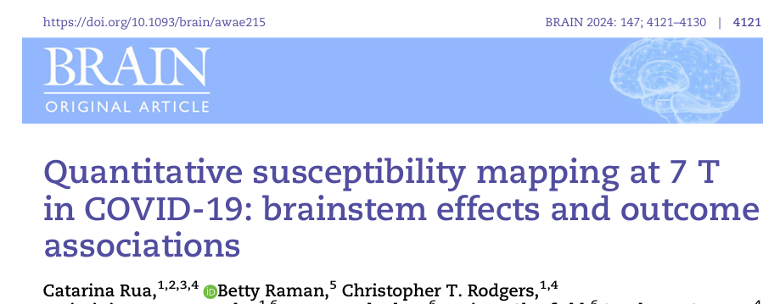
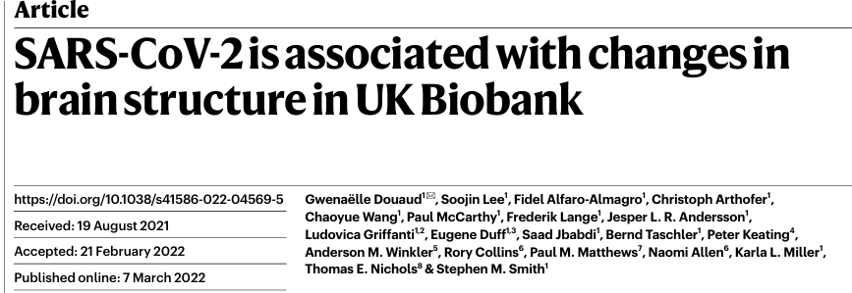
UK Biobank study 2022: a natural experiment (adults)
Longitudinal study with scans pre- and post- Covid infection up to 3 years apart compared with control group who had not had covid
Grey matter reduction in volume or contrast, over time, is greater for covid patients relative to non-covid patients
R and L parahippocampal gyrus, anterior cingulate, temporal poles, L orbitofrontal cortex and insula
Emotion processing/memory/executive function networks
Brain stem changes also found (adults) Rua et al 2024
Many studies since with wide range of findings

Slide 7
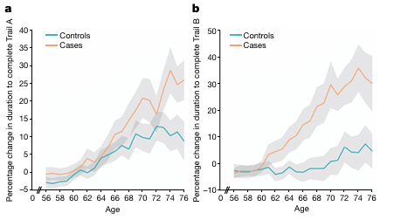
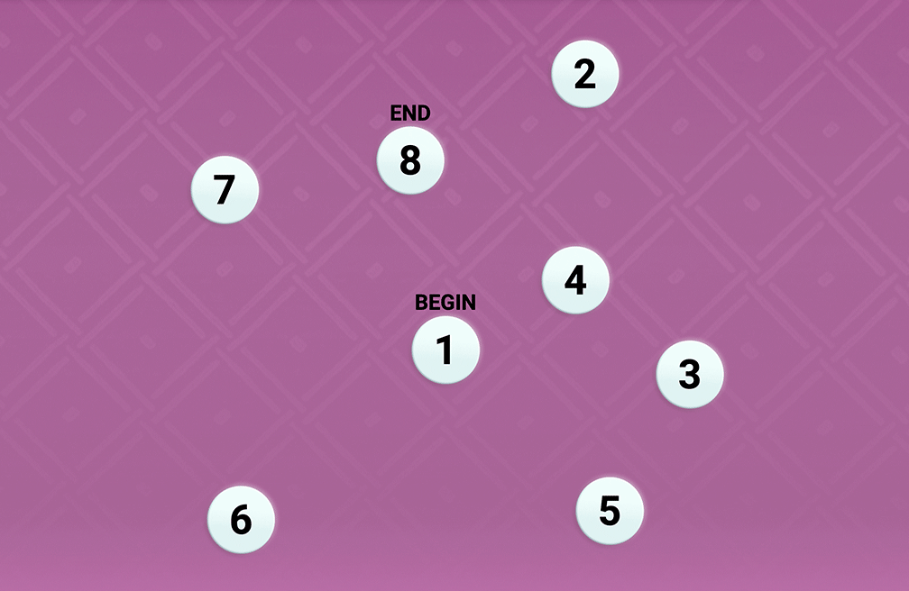
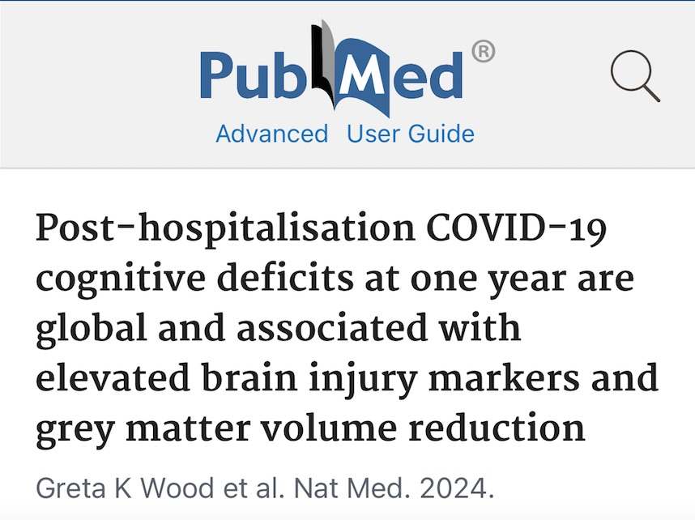
Functional significance
Pre- and post- cognitive test using Trail A -
- and Trail B (alternating numbers with letters)
Tests of visual attention, response inhibition, processing speed, motor coordination, EF
Covid patients slowed significantly more between time points, even when the 15/401 hospitalized patients removed from analysis
A control group was still available in 2021
Cognitive and EF deficits in adults confirmed by many other studies eg reviewed by Wood et al 2024

Slide 8
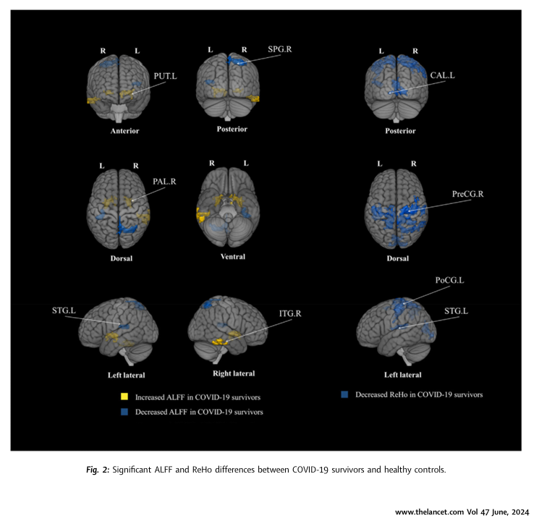


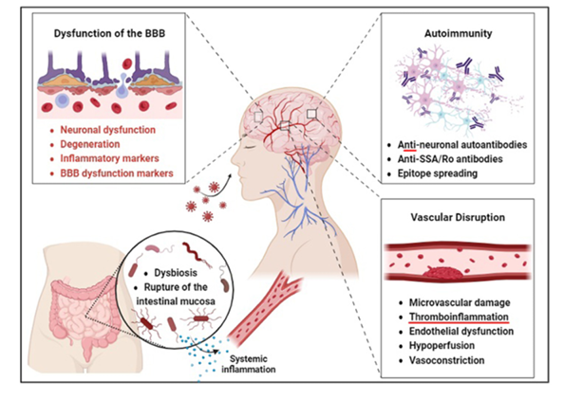
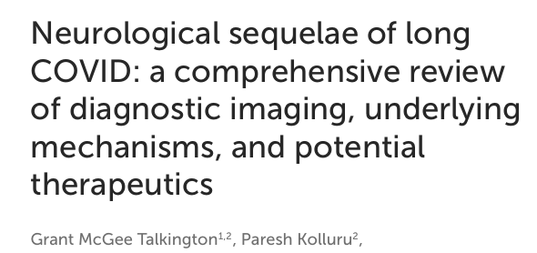
Other brain changes (adults)
fMRI, PET and EEG changes even with normal cognitive
performance – compensation occurring

Slide 9
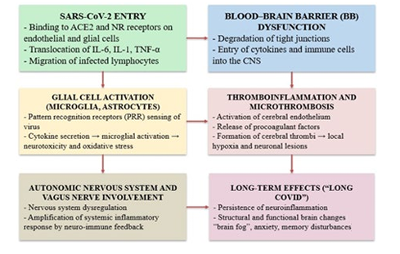
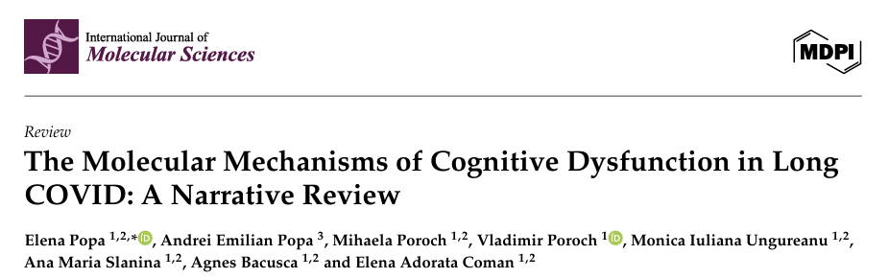
Mechanisms of neurocovid – a work in progress worldwide
We already know many viruses affect the brain eg
rabies, HIV, H1N1, CMV, EBV, measles
Acute neurological findings in children
are well-documented but LC studies still lacking

Slide 10
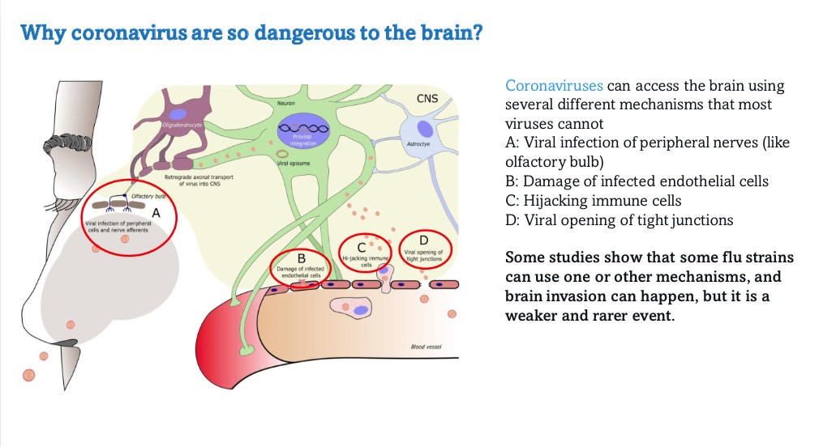
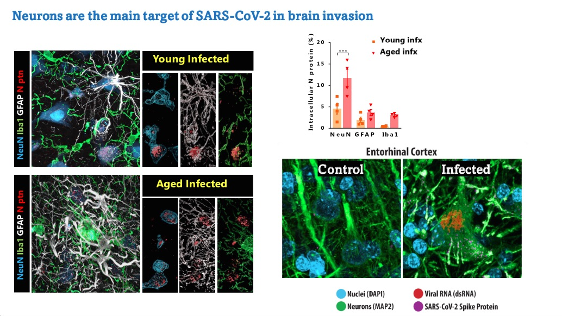
Neuroinvasion – acute phase
Images and figure courtesy of Danielle Beckmann
Neurons are primary targets for neuroinvasion by covid-19. These are neurons of monkeys infected acutely with covid compared with uninfected.

Slide 11
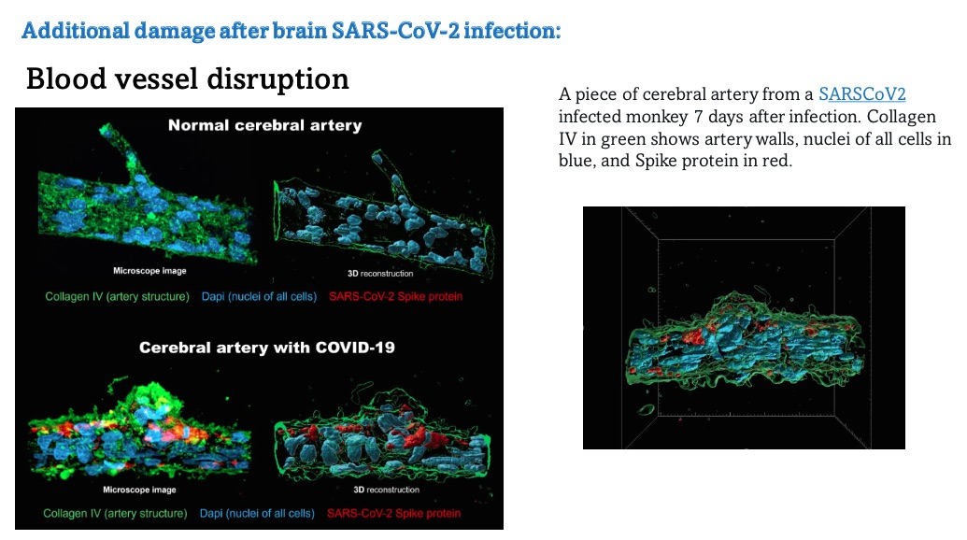
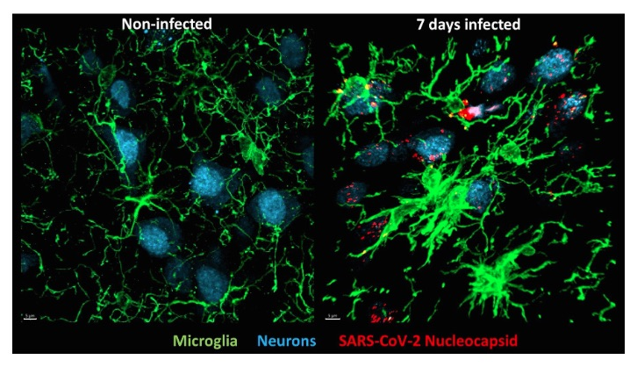
Acute phase cerebrovascular abnormalities and neuroinflammation
Images courtesy of Danielle Beckmann
Section of cerebral artery in a monkey 7 days post-infection with covid-19. Cerebral microhaemorrhages can be widespread
Microglia are activated (not usually invaded) by covid-19 infection
and are dysfunctional as part of an inflammatory process

Slide 12
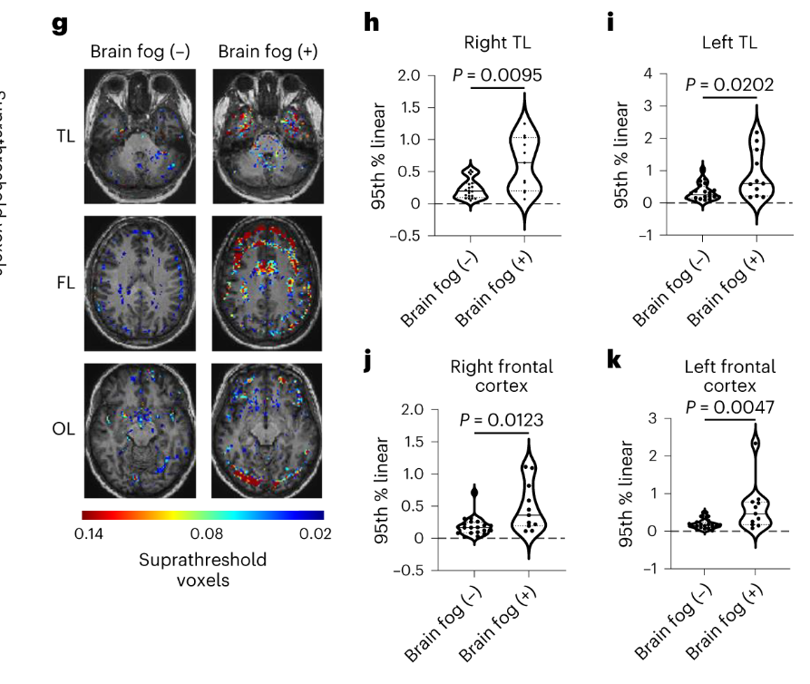
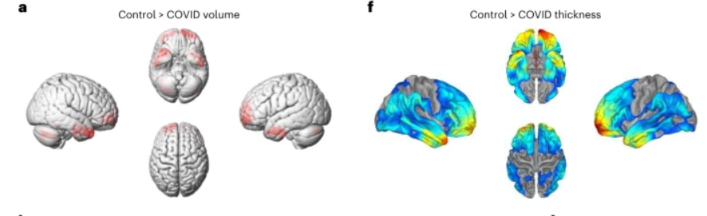
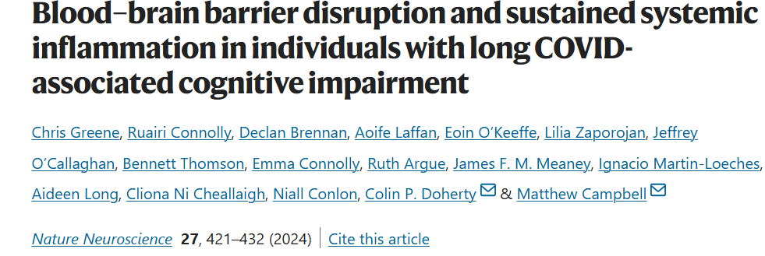
BBB disruption in LC and clinical implications
Greene et al used dynamic contrast-enhanced MRI to measure vascular integrity and density and thus estimate BBB disruption
They found increased BBB alterations in those with LC and “brain fog” compared with LC and no brain fog
Patterns of volume and thickness loss in cortex were different in clinically recovered, LC with no brain fog and LC with brain fog but all showed changes compared with controls
Superior and middle temporal gyrus volume loss were seen only in the LC patients who had “brain fog”

Slide 13
Examples of LC clinical and therapeutic implications
Autoimmune and vascular disorders can cause encephalitis/very severe headaches/movement disorders
Network disruption of eg serotonin networks- may benefit from antihistamines as well as antidepressants/anxiolytics
Significant proportion of depressive disorders in adults are now known to be driven by inflammation and treated by anti-inflammatories alongside antidepressants
Microhaemorrhages and clotting abnormalities can occur anywhere in the brain
Neuronal loss in brain areas relevant to executive function, memory and emotional processing
Lack of perfusion/dysautonomia
Prenatal infection associated with developmental disorders at age 3

Slide 14
CNS manifestations of Long Covid to look for in clinical settings – next session
“Psychiatric” disorders – anxiety, depression, psychosis
Sensory processing changes – tinnitus, hearing loss, visual changes, anosmia, dysgeusia, hypersensitivities
Motor – dystonia, tics, coordination difficulties
Cognitive – attention, executive function, memory
Fatigue – cognitive and bodily
Encephalitic presentations with fluctuating symptoms
Eating disorders – anorexia, ARFID, loss of appetite
Sleep disorders
Possibly seizure disorders

