Slide 1


The Covid-Kids Study
Overview
Dr Elmudathir Abdelrahman
Dr Rae Duncan
Prof Ioakim Spyridopoulos

Slide 2
Long COVID Literature: Limited Paediatric Studies
Growing small single-centre studies suggest possible subclinical cardiac, pulmonary, and vascular changes even after mild infection
Notes:
There’s a clear imbalance in the Long COVID literature — children are simply under-studied.
Most studies are adult-focused, and paediatric data remain limited, so findings cannot be directly extrapolated to children.

Slide 3
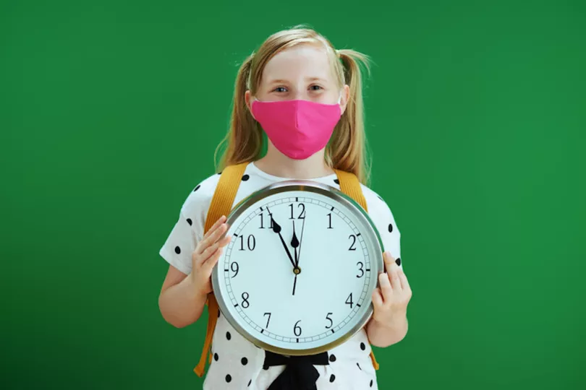

What large paediatric cohorts have taught us about Long COVID
CLoCK
Largest national matched longitudinal cohort of CYP (11–17 years), England
Defined prevalence and symptom trajectories of paediatric Long COVID
Established a population-based working definition of paediatric Long COVID
Largest multi-site paediatric observational cohort, targeting ~15,100 participants
Longitudinal, multi-system clinical phenotyping across childhood and young adulthood
Systematic biospecimen collection, including cardiovascular assessments
Notes:
Before presenting our study, it’s worth highlighting what the largest paediatric cohorts have taught us.
CLoCK defined prevalence and symptom patterns, while RECOVER provides scale and longitudinal biosampling.
Together, they form the foundation of paediatric Long COVID research.

Slide 4
Notes:
What remains less well understood is the underlying biology driving these persistent symptoms in children.
In particular, we still lack biomarker-led, mechanistic phenotyping that links symptoms to biological pathways. That gap is where COVID-KIDS is positioned.”

Slide 5
The Covid-Kids Study
Funder: Balvi/Kanro £2.1M
Sponsor: Newcastle JRO
Recruitment Site: Newcastle Hospitals NHS Foundation Trust
PPI Partners: Long Covid Kids Charity
Specialist Laboratory Partners:
Newcastle University, Sheffield Hallum University, Cardiff University, Stellenbosch University SA, Yale School of Medicine USA, National Phenome Centre Australia
Notes:
COVID-KIDS is a nationally sponsored, charity-supported study led at Newcastle, with dedicated funding and integrated patient and public involvement.It brings together clinical recruitment within the NHS and specialist laboratory partners across the UK, Europe, the US, and Australia to enable deep biological and mechanistic investigation of paediatric Long COVID.”

Slide 6
Our Protocol Development Group
CHIEF INVESTIGATOR: Prof Ioakim Spyridopolous, Chair Cardiogerentology, Newcastle University, Newcastle, UK
PRINCIPLE INVESTIGATOR: Dr Rae Duncan, Consultant Cardiologist, Newcastle, UK
RESEARCH FELLOW: Dr Elmudathir Abdelrahman, Consultant Paediatrician, Newcastle, UK
Dr Abbas Khushnood, Consultant Paediatric Cardiologist, Newcastle, UK
Dr Emma Weisblatt, Consultant Paediatric Neurodevelopmental Psychiatrist, Cambridge, UK
Dr Caroline Dalton, Immunology & Neuroscience, Sheffield, UK
Prof David Price, Immunology, Cardiff, UK
Dr Binita Kane, Consultant Respiratory Physician, TLCC, UK
Dr Elle Balmer, Consultant Paediatrician, Manchester, UK
Dr Kelly Fearnley, Hull, UK
Prof Danilo Bounsenso, Consultant Paediatrician in Infectious Diseases, Rome, Italy
Prof Resia Pretorius, Physiological Sciences, Stellenbosch, South Africa
Prof David Putrino, Neuroscientist & Rehabiliation Medicine, NY, UK
Dr Danielle Beckman, Neuroscience, California, UK
Dr Asad Khan, Consultant, Respiratory Physician (Rtd), Manchester, UK
Mrs Sammie McFarland, Long Covid Kids Charity, Uk
Mrs Helen Goss, Long Covid Kids Charity
Notes:
The protocol was developed collaboratively by a multidisciplinary team spanning paediatric cardiology, infectious diseases, immunology, neuroscience, respiratory medicine, and physiology, with national and international partners experienced in managing children with Long COVID.”

Slide 7
The COVID-Kids Study
Repeated infections and rising prevalence increase concern for cumulative organ effects
Neurological:
Neurocognitive, neuropsychiatric, ANS
Immunological:
Innate and Adaptive, chronic inflammation
Cardiovascular
Endothelial function, Coagulation, Cardiac contractility, Cardiometabolic function
Establishing biomarkers for different Long Covid phenotypes in children
Notes:
Long COVID in children appears to affect multiple organ systems, most prominently the nervous, immune, and cardiovascular systems.COVID-KIDS is designed to interrogate these systems in parallel and identify biological signatures that distinguish different paediatric Long COVID phenotypes.”

Slide 8
The COVID-Kids Study
Comparison study:
Children with previous SARS2 infection & Long Covid (LC)
Children with previous SARS infection & no Long Covid
Covid Naïve Pre-pandemic plasma samples
Children will undergo:
PROMS (virtually)
Neurocognitive & MH assessments (virtually)
NASA lean test with TCD (subgroup)
EndoPAT
Myocardial deformation imaging echocardiogram
Blood Test: O-link proteomic >5000 potential biomarkers PLUS specialist lab studies – results compared with Covid naïve childrens samples
Notes:
COVID-KIDS is a controlled comparison study.We include children with Long COVID, children with prior infection and full recovery, and COVID-naïve controls.Screening is performed virtually, followed by targeted blood sampling and in-person cardiovascular and autonomic assessments.

Slide 9
The COVID-Kids Study
Establishing Baseline Symptoms across the 7 PCOS Domains + one additional domain:
Notes:
Assessments span multiple clinical domains to capture the breadth of symptoms and functional impairment.This ensures a structured, system-wide evaluation of affected children.

Slide 10
Neurological:
1.Neurocognitive:
Assessments of neurocognitive, executive functioning and IQ
2. Neuropsychiatric:
Screening for PANS, tics, MH, other
3. Potential neurological biomarkers:
O-link proteomics and ELISA
4. Autonomic Nervous System
NASA lean test & Transcranial Doppler
Notes:
We assess neurological involvement through cognitive, neuropsychiatric, autonomic, and biomarker testing.

Slide 11
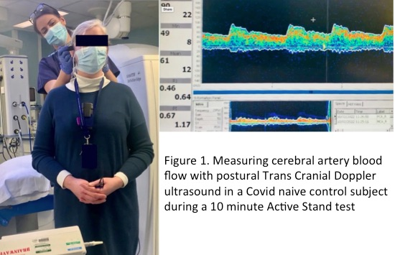
Neurological: ANS
Notes:
NASA Lean testing and transcranial Doppler are used to assess autonomic dysfunction by monitoring haemodynamics and postural cerebral blood-flow changes.

Slide 12
Immunological & Inflammatory:
1.Cyokine & chemokine panels:
O-link
2. Peripheral Blood Mononuclear Cells analysis:
Specialist labs
3. Complement:
Specialist labs

Slide 13
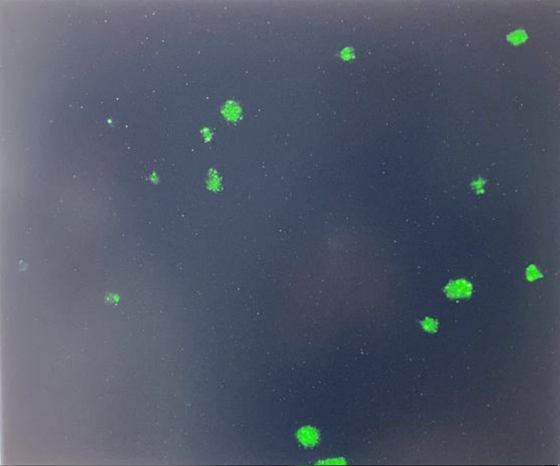
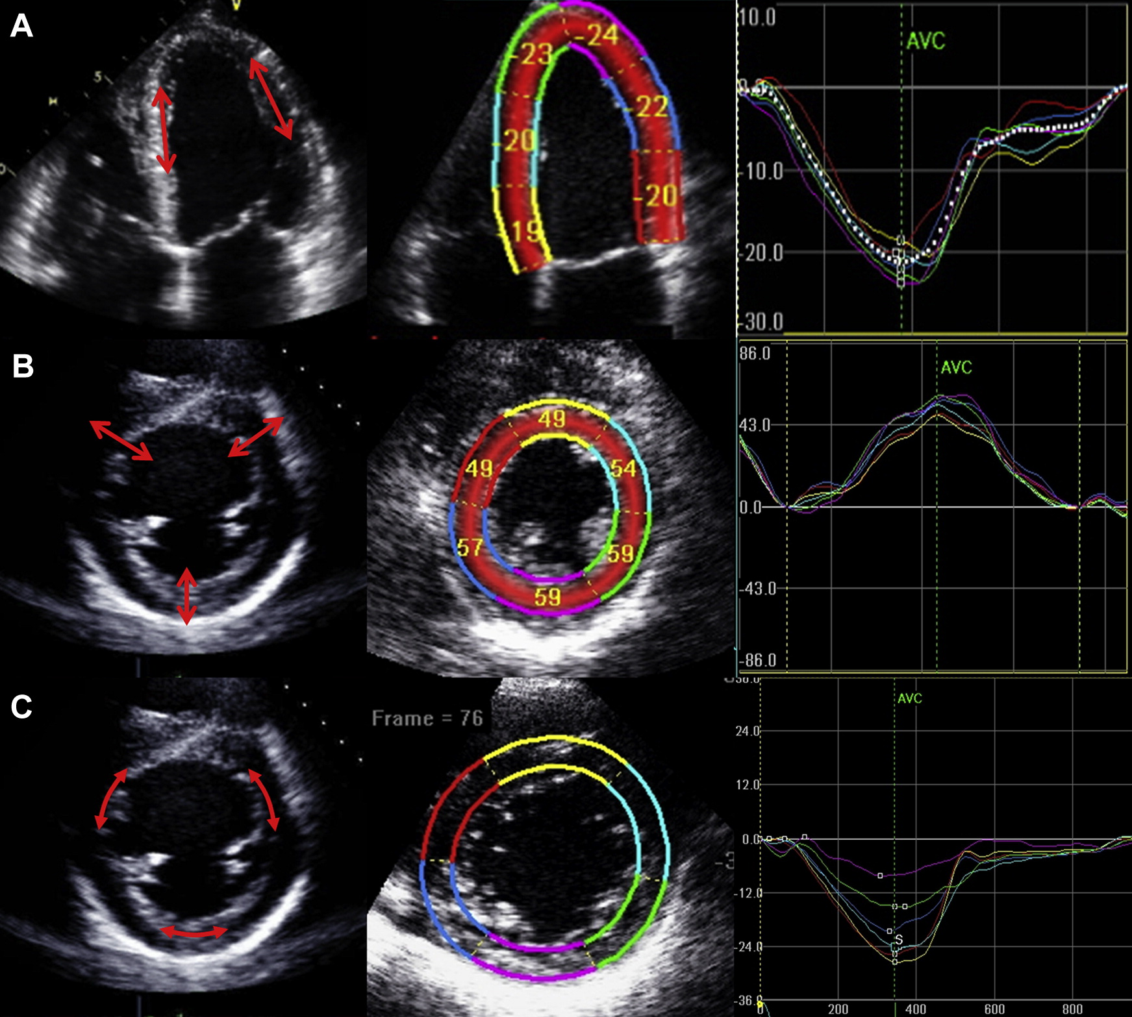
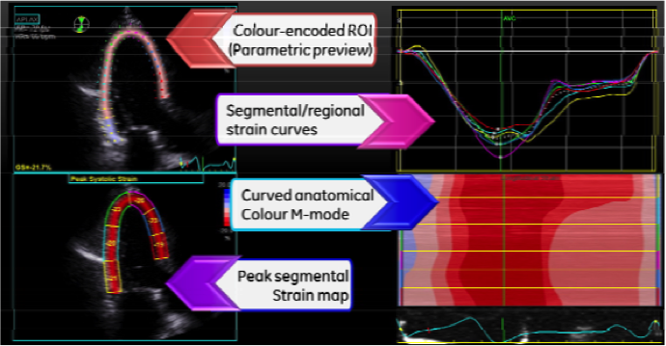
Cardiovascular:
1.Vascular:
EndoPAT &Endothelial blood biomarkers
Clinical: BP, HR, “Covid toes”, acrocyanosis
2. Coagulation:
Fibrinaloid microclot testing (specialist labs)
Blood markers of coagulation
3. Lipoproteins & Cardiometabolic profiling:
4. Heart function
Myocardial deformation imaging
Notes:
EndoPAT™ provides a non-invasive assessment of endothelial function, alongside coagulation, cardiometabolic profiling, and echocardiographic evaluation of cardiac haemodynamics in post-COVID dysautonomia.

Slide 14
Questions we hope to Answer:
Key Clinical Questions
Is Covid causing organ damage/dysfunction (cardiac, vascular, metabolic, immunologic, neurocognitive, autonomic) in children with Long Covid symptoms, and what is the prevalence?
Is similar organ damage/dysfunction occurring silently in previously infected children without symptoms, and what is the prevalence?
Notes:
First, we’re asking whether COVID is associated with overt or silent multi-organ dysfunction in children, and what the true prevalence is.”

Slide 15
Questions we hope to Answer:
Biomarker Questions
Can we identify and validate blood biomarkers to diagnose these changes?
Do specific biomarkers correlate with phenotypes or symptom clusters?
Can these biomarkers support diagnosis and monitor treatment response in research & future treatment trials?
Notes:
Second, we aim to identify and validate blood biomarkers that define phenotypes and support diagnosis and monitoring.

Slide 16
Our Collaborative Partners
PPI Partner:
The Long Covid Kids Charity
Laboratory Partners:
Dr Caroline Dalton Lab, Sheffield Hallum University
Prof David Price Lab, Cardiff University
Prof Resia Pretorius Lab, Stellenbosch University
Profs Julien Wist & Jeremy Nicholson, NPC
Prof Akiko Iwasaki Lab, Yale University School of Medicine
Thank you to Balvi/Kanro and Eleanor Hamilton Foundation for enabling this Research
Notes:
Finally, sincere thanks to our collaborators and sponsors whose support makes this work possible.

